Slide 1
MATH/CMSC 456 :: UPDATED COURSE INFO
Instructor: Gorjan Alagic (galagic@umd.edu)
Guest instructor: Carl Miller (camiller@umd.edu), ATL 3100K
Textbook: Introduction to Modern Cryptography, Katz and Lindell;
Webpage: alagic.org/cmsc-456-cryptography-spring-2020/
Piazza: piazza.com/umd/spring2020/cmsc456
ELMS: active, slides and reading posted there.
Gradescope: active, access through ELMS.
TAs (Our spot: shared open area across from AVW 4166)
Elijah Grubb (egrubb@cs.umd.edu) 11am-12pm TuTh (AVW);
Justin Hontz (jhontz@terpmail.umd.edu) 1pm-2pm MW (AVW);
Additional help:
Chen Bai (cbai1@terpmail.umd.edu) 3:30-5:30pm Tu (2115 ATL – inside JQI)
Bibhusa Rawal (bibhusa@terpmail.umd.edu) 3:30-5:30pm Th (2115 ATL – inside JQI)
Homework 4 was posted today, and is due March 12.
Notes:
Classroom Support: 301-405-2500

Slide 2
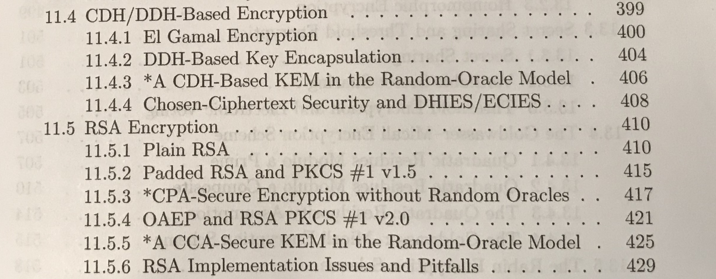
READING FOR TODAY
We were skipping two subsections. I decided to drop subsection 11.5.4 also. (You won’t be responsible for the material there.)

Slide 3
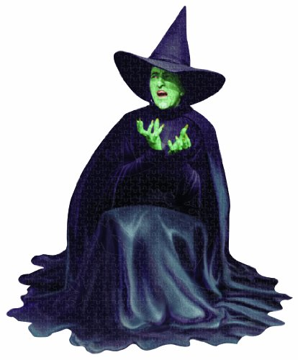








RECAP: DIFFIE-HELLMAN KEY EXCHANGE
G = cyclic group with generator g.
Alice chooses random $x$and sends $g^{x}$ to Bob.
Bob chooses random $y$and sends${ g}^{y}$ to Alice.
Alice computes ${\left(g^{y}\right)}^{x}=g^{xy}.$ Bob computes ${\left(g^{x}\right)}^{y}=g^{xy}$.
They then have a shared secret.
Adversary
$g^{x}$
$x$
$g^{y}$
$y$
$g^{xy}$
$g^{xy}$

Slide 4








RECAP: FORMAL MODELS OF PUBLIC-KEY CRYPTO
We went through various definitions of security for public-key crypto.
All of them were based on indistinguishability experiments.
IND-CPA for public-key encryption
IND-CCA for public-key encryption
CPA for key encapsulation
CPA = “chosen plaintext attack”
CCA = “chosen ciphertext attack”
$$A$$
$$m_{0}$$
$$c$$
$$A$$
$$c$$
$$Enc_{k}\left(m_{b}\right)$$
$$m_{1}$$
$$b′$$

Slide 5
PLAN FOR TODAY
1. El Gamal encryption
RSA encryption revisited.
3. The impact of Shor’s algorithm on cryptography.
We are going to overview some security proofs from the textbook.

Slide 6
EL GAMAL ENCRYPTION

Slide 7

EL GAMAL (PUBLIC-KEY ENCRYPTION)
Let G be a PPT algorithm that, on input $1^{n}$, generates (G,q,g).
$Gen$: Alice runs G, broadcasts result.
She chooses random $x∈\left\{1,2,…,q\right\}$ and sends $g^{x}$.
Adversary
$g^{x}$
$x$
Size of G
Generator
Cyclic group

Slide 8



EL GAMAL (PUBLIC-KEY ENCRYPTION)
$Enc$: Bob computes his message $m∈G$.
He chooses random $y∈\left\{1,2,…,q\right\}$ and sends $g^{y}$ and${ c≔\left(g^{x}\right)}^{y}∙m$.
$Dec$: Alice computes:
$$c∙{\left[{\left(g^{y}\right)}^{−1}\right]}^{x}=g^{xy}m{∙g}^{−xy}=m.$$
Adversary
$g^{x}$
$x$
$$g^{y}, c$$
$m$
Correct decryption is guaranteed by the defining properties of a cyclic group (last lecture).

Slide 9
SECURITY PROOFS
Our security proofs should have:
- Clearly identified algorithms.
The procedures used in algorithms may sometimes be unspecified (e.g., G), but parameters should be fully stated.
- Precisely stated computational hardness assumptions.
- Rigorous logical steps from assumptions to conclusion.

Slide 10





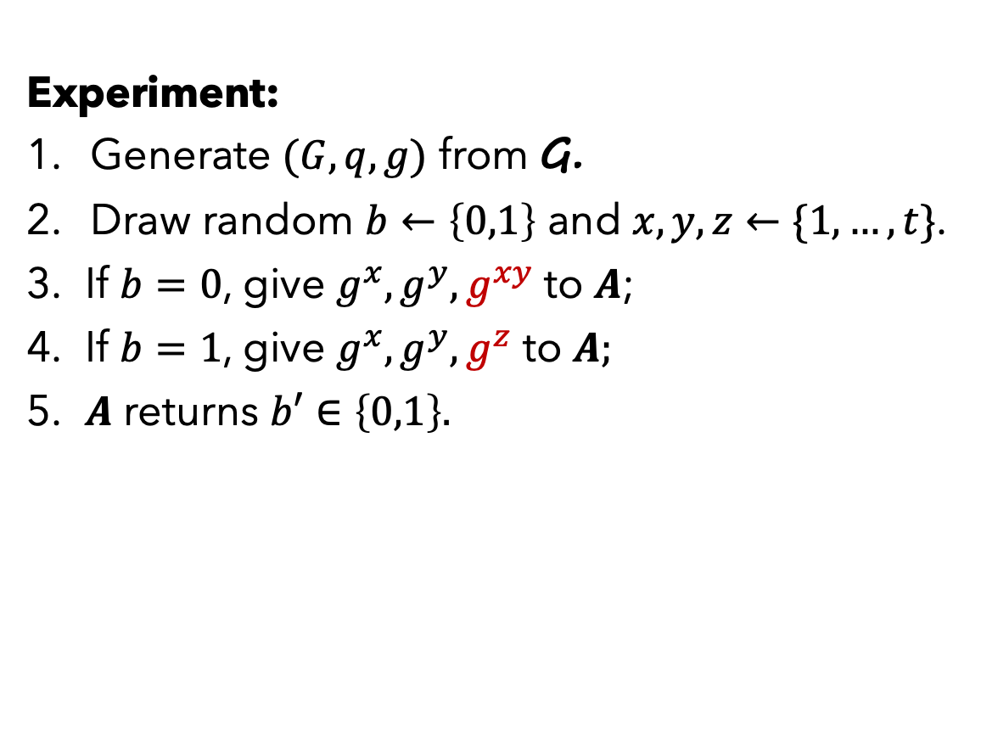







THE DECISIONAL DIFFIE-HELLMAN PROBLEM
Experiment:
Generate $(G,q,g)$ from G.
Draw random $b←\left\{0,1\right\}$ and $x,y,z←\{1,…,t\}$.
If $b=0$, give $g^{x}, g^{y}, g^{xy}$ to $A$;
If $b=1$, give $g^{x}, g^{y}, g^{z}$ to $A;$
$A$ returns $b′∈\left\{0,1\right\}.$
$$b=0$$
$$g^{x}$$
$$A$$
$$g^{y}$$
$$b′$$
$$g^{xy}$$
$$g^{x}$$
$$A$$
$$g^{y}$$
$$b′$$
$$g^{z}$$
$$b=1$$
Definition. The DDH problem is hard relative to G if, for any PPT $A$,
$$| Pr\left[A=1|b=0\right]−\operatorname{Pr}\left[A=1 | b=1\right]|≤negl\left(n\right).$$

Slide 11








SECURITY CLAIM
Theorem: If the DDH problem is hard relative to G, then the El Gamal encryption scheme is IND-CPA secure.
$b$ (random)
Proof sketch:
We want to prove that Eve has no better than a negligible advantage of guessing $b$ in this experiment.
$$m_{0}$$
$$c$$
$y$ random
$$m_{1}$$
$$c≔$$
$g^{xy}m_{b}$
$$g^{y}$$
$$g^{x}$$
$$b′$$
Experiment E

Slide 12


SECURITY CLAIM
Theorem: If the DDH problem is hard relative to G, then the El Gamal encryption scheme is IND-CPA secure.
$b$ (random)
Proof sketch:
We want to prove that Eve has no better than a negligible advantage of guessing $b$ in this experiment.
Suppose we were to modify: replace $g^{xy}$ with a uniformly random element $g^{z}$.
Eve now gets no information at all about b, so her probability of a correct guess is ½.
And by DDH, the outcome of Experiment F is only negligibly different from Experiment E!
$$m_{0}$$
$$c$$
$y$ random
$$m_{1}$$
$$c≔$$
$g^{z}m_{b}$
$$g^{y}$$
$$g^{x}$$
$$b′$$
Experiment F

Slide 13
RSA ENCRYPTION REVISITED

Slide 14
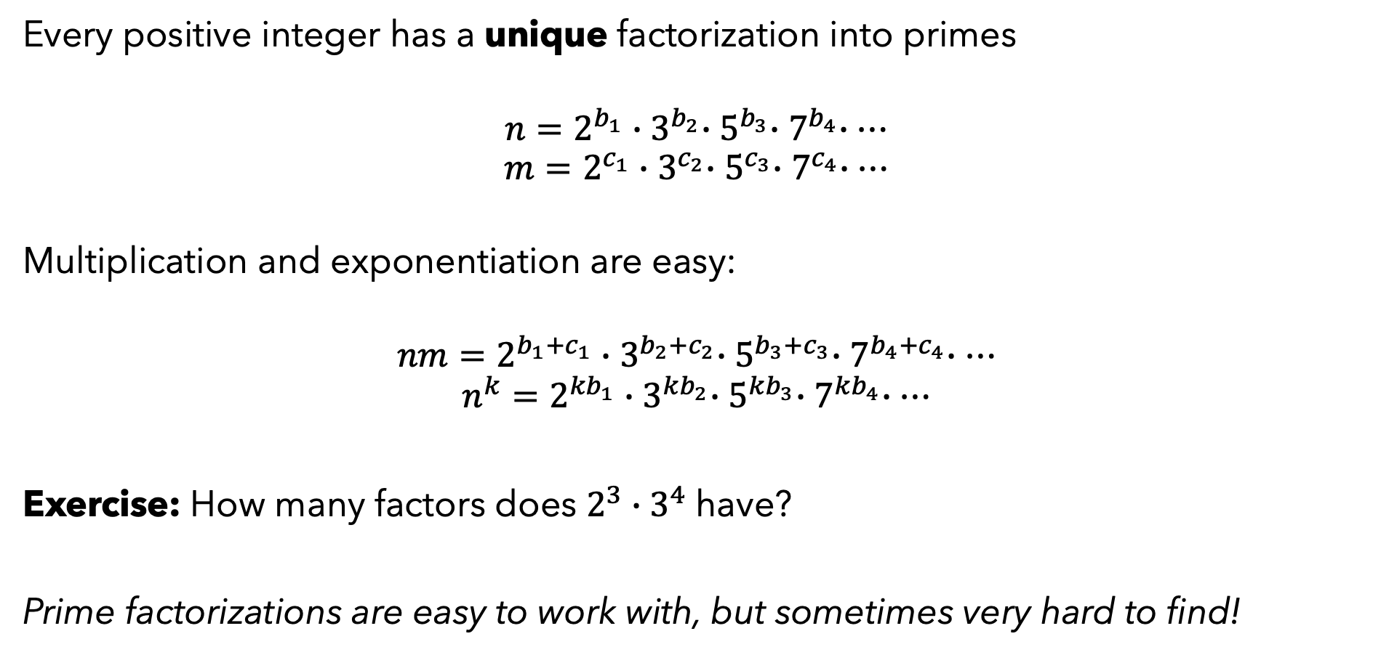
A QUICK “PRIMER” ON PRIME FACTORIZATION
Every positive integer has a unique factorization into primes
$$n=2^{b_{1}}{∙3}^{b_{2}}{∙5}^{b_{3}}{∙7}^{b_{4}}∙…$$
$$m=2^{c_{1}}{∙3}^{c_{2}}{∙5}^{c_{3}}{∙7}^{c_{4}}∙…$$
Multiplication and exponentiation are easy:
$$nm=2^{b_{1}+c_{1}}{∙3}^{b_{2}+c_{2}}{∙5}^{b_{3}+c_{3}}{∙7}^{b_{4}+c_{4}}∙…$$
$$n^{k}=2^{{kb}_{1}}{∙3}^{kb_{2}}{∙5}^{kb_{3}}{∙7}^{kb_{4}}∙…$$
Exercise: How many factors does $2^{3}∙3^{4}$ have?
Prime factorizations are easy to work with, but sometimes very hard to find!

Slide 15
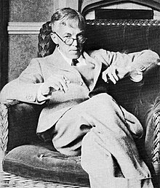
A QUOTE FROM A MATHEMATICAL ANTI-HERO
“If useful knowledge is […] knowledge which is likely […] to contribute to the material comfort of mankind […] then the great bulk of higher mathematics is useless. Modern geometry and algebra, the theory of numbers, the theory of aggregates and functions, relativity, quantum mechanics—no one of them stands the test much better than another […]”
-- G. H. Hardy, A Mathematician’s
Apology, 1940
Negative predictions are dangerous…
Source: www.wikipedia.org

Slide 16




SINGLE-BIT RSA ENCRYPTION
GenRSA:
Let n = security parameter.
1. Alice generates two random primes p,q of length n, and computes N=pq.
2. Alice chooses random $e∈ℤ_{\left(p−1\right)\left(q−1\right)}^{∗}$ and computes its multiplicative inverse (d).
$$N,e$$
$$d$$
$$m∈\{0,1\}$$

Slide 17


SINGLE-BIT RSA ENCRYPTION
Enc:
Bob chooses random $r∈ℤ_{N}^{∗}$ such that $lsb\left(r\right)=m$.
He computes $c≔[r^{e} mod N]$.
Dec:
1. Alice computes $r=\left[c^{d} mod N\right]$, recovers $m$.
$$N,e$$
$$c$$
$$d$$
$$m∈\{0,1\}$$
“lsb(r)” means [r mod 2].

Slide 18


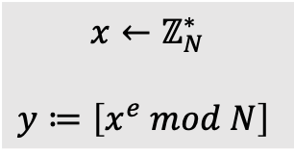







A “HARD-CORE” RSA ASSUMPTION
Experiment:
1. Run GenRSA to obtain $N,e.$
2. Compute random $x∈ℤ_{N}^{∗}$.
3. Send $N, e,$ and $[x^{e} mod N]$ to $A.$
4. $A$ outputs bit $b$.
$A$ wins if $b=lsb\left(x\right).$
$$GenRSA$$
$$N$$
$x←ℤ_{N}^{∗}$
$$y≔\left[x^{e} mod N\right]$$
$$N$$
$$A$$
$$e$$
$$b$$
$$e$$
$$y$$
Assumption. The probability that $A$ wins is $≤\frac{1}{2}+negl\left(n\right).$

Slide 19
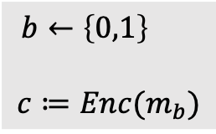


SECURITY CLAIM
Theorem: If the hard-core RSA assumption holds, then single-bit RSA is IND-CPA secure.
Proof sketch:
Consider the IND-CPA experiment. (The bit b is chosen at random.)
$$m_{0}$$
$b←\left\{0,1\right\}$
$$c≔Enc(m_{b})$$
$$c$$
$$m_{1}$$
$$N,e$$
$$b′$$

Slide 20
SECURITY CLAIM
Theorem: If the hard-core RSA assumption holds, then single-bit RSA is IND-CPA secure.
Proof sketch:
Consider the IND-CPA experiment. (The bit b is chosen at random.)
Suppose that Eve has a non-neg. advantage.
$$m_{0}$$
$b←\left\{0,1\right\}$
$$c≔Enc(m_{b})$$
$$c$$
$$m_{1}$$
$$N,e$$
$$b′$$

Slide 21

SECURITY CLAIM
Theorem: If the hard-core RSA assumption holds, then single-bit RSA is IND-CPA secure.
Proof sketch:
Consider the IND-CPA experiment. (The bit b is chosen at random.)
Suppose that Eve has a non-neg. advantage.
We can assume that $m_{0}=0$, $m_{1}=1$.
$$m_{0}$$
$b←\left\{0,1\right\}$
$$c≔Enc(m_{b})$$
$$c$$
$$m_{1}$$
$$N,e$$
$$b′$$

Slide 22



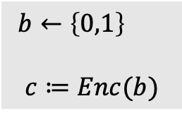
SECURITY CLAIM
Theorem: If the hard-core RSA assumption holds, then single-bit RSA is IND-CPA secure.
Proof sketch:
Consider the IND-CPA experiment. (The bit b is chosen at random.)
Suppose that Eve has a non-neg. advantage.
We can assume that $m_{0}=0$, $m_{1}=1$.
$$0$$
$b←\left\{0,1\right\}$
$$c≔Enc(b)$$
$$c$$
$$1$$
$$N,e$$
$$b′$$

Slide 23


SECURITY CLAIM
Theorem: If the hard-core RSA assumption holds, then single-bit RSA is IND-CPA secure.
$$N,e′$$
Proof sketch:
Consider the IND-CPA experiment. (The bit b is chosen at random.)
Suppose that Eve has a non-neg. advantage.
We can assume that $m_{0}=0$, $m_{1}=1$.
The gray box is the same (up to negligible probability) as the one from the hard-core RSA assumption! (With $b≔lsb\left( x \right)$.)
$b←\left\{0,1\right\}$
$$c≔Enc(b)$$
$$c$$
$$b′$$

Slide 24
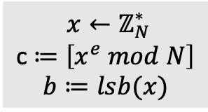

SECURITY CLAIM
Theorem: If the hard-core RSA assumption holds, then single-bit RSA is IND-CPA secure.
$$N,e′$$
Proof sketch:
Consider the IND-CPA experiment. (The bit b is chosen at random.)
Suppose that Eve has a non-neg. advantage.
We can assume that $m_{0}=0$, $m_{1}=1$.
The gray box is the same (up to negligible probability) as the one from the hard-core RSA assumption! (With $b≔lsb\left( x \right)$.)
The adversary can achieve a non-negligible advantage at the hard-core RSA experiment. Contradiction.
$x←ℤ_{N}^{∗}$
c $≔\left[x^{e} mod N\right]$
$$b≔lsb(x)$$
$$c$$
$$b′$$

Slide 25
CONCLUSION
We defined & sketched security proofs for El Gamal and RSA encryption.
In these miniature security proofs, the underlying assumption looks similar to the security claim itself. In longer security proofs, the two claims may look pretty different.
Security proofs are good for judging and comparing different protocols.

Slide 26
EPILOGUE
RSA is one of the most widely used cryptosystems today.
However, it is not the cryptosystem of the future. Why?

Slide 27
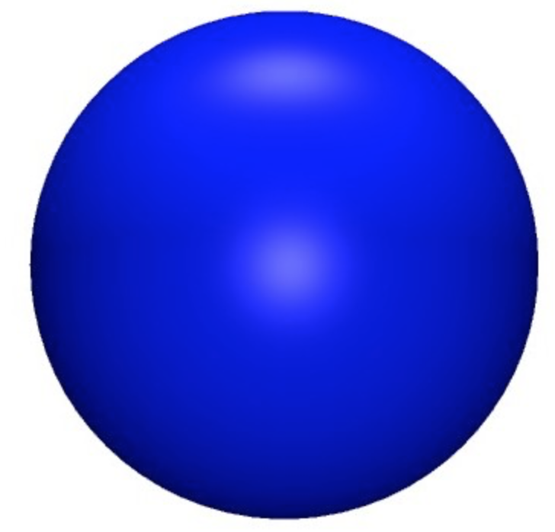
EPILOGUE
0
1
Digital Computing | Bits
Randomized Computing | Random bits
Quantum Computing | Qubits
0
1
0
1
In theory, a quantum computer can factor numbers in polynomial time, breaking RSA. (Shor’s algorithm.)

Slide 28
EPILOGUE
“There is strong commercial interest in deploying post-quantum cryptography even before such a quantum computer has been built. Companies and governments cannot afford to have their private communications decrypted in the future, even if that future is 30 years away. For this reason, there is a need to begin the transition to post-quantum cryptography as soon as possible.”
-- Quantum Computing: Progress and Prospects
National Academies of Sciences, Engineering, and Medicine

Slide 29
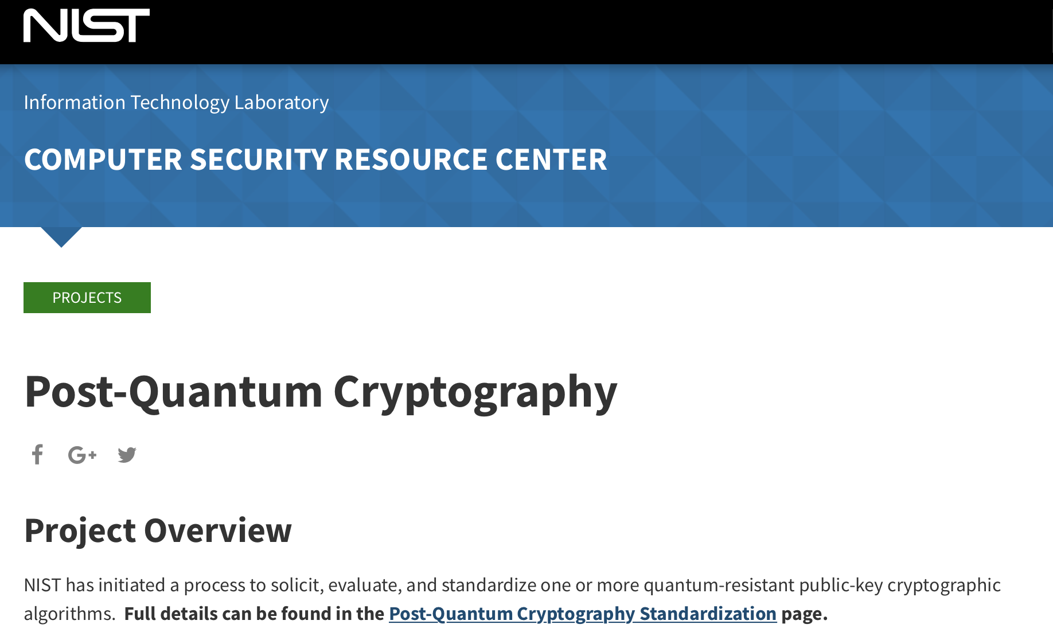
EPILOGUE
NIST is preparing to write “postquantum” cryptographic standards.

