Slide 1
MATH/CMSC 456 :: UPDATED COURSE INFO
Instructor: Gorjan Alagic (galagic@umd.edu)
Guest instructor: Carl Miller (camiller@umd.edu), ATL 3100K
Textbook: Introduction to Modern Cryptography, Katz and Lindell;
Webpage: alagic.org/cmsc-456-cryptography-spring-2020/
Piazza: piazza.com/umd/spring2020/cmsc456
ELMS: active, slides and reading posted there.
Gradescope: active, access through ELMS.
TAs (Our spot: shared open area across from AVW 4166)
Elijah Grubb (egrubb@cs.umd.edu) 11am-12pm TuTh (AVW);
Justin Hontz (jhontz@terpmail.umd.edu) 1pm-2pm MW (AVW);
Additional help:
Chen Bai (cbai1@terpmail.umd.edu) 3:30-5:30pm Tu (2115 ATL – inside JQI)
Bibhusa Rawal (bibhusa@terpmail.umd.edu) 3:30-5:30pm Th (2115 ATL – inside JQI)
Current readings:
Mar 3: 359-372, 375-382, 387-399
Mar 5: pp. 399-432 (skip subsections 11.4.3 and 11.5.5)
Notes:
Classroom Support: 301-405-2500

Slide 2
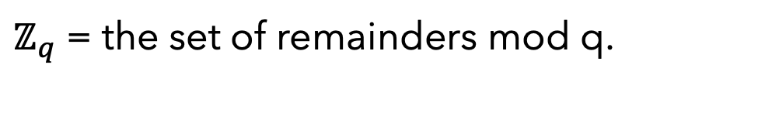
RECAP: EFFICIENT OPERATIONS MOD q
$ℤ_{q}$ = the set of remainders mod q.
 | Efficient to compute? | Efficient to invert?
Addition | YES | YES
Multiplication | YES | YES
Exponentiation | YES | ?
We found that exponentiation is efficient to invert if q is prime.
If q is not prime, it may be very difficult.

Slide 3
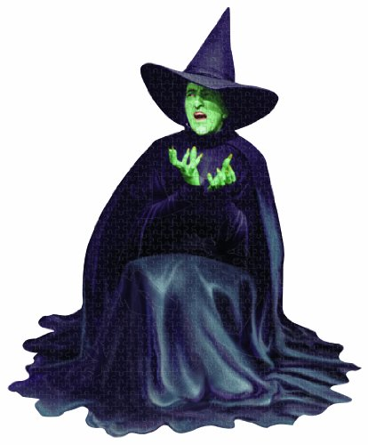


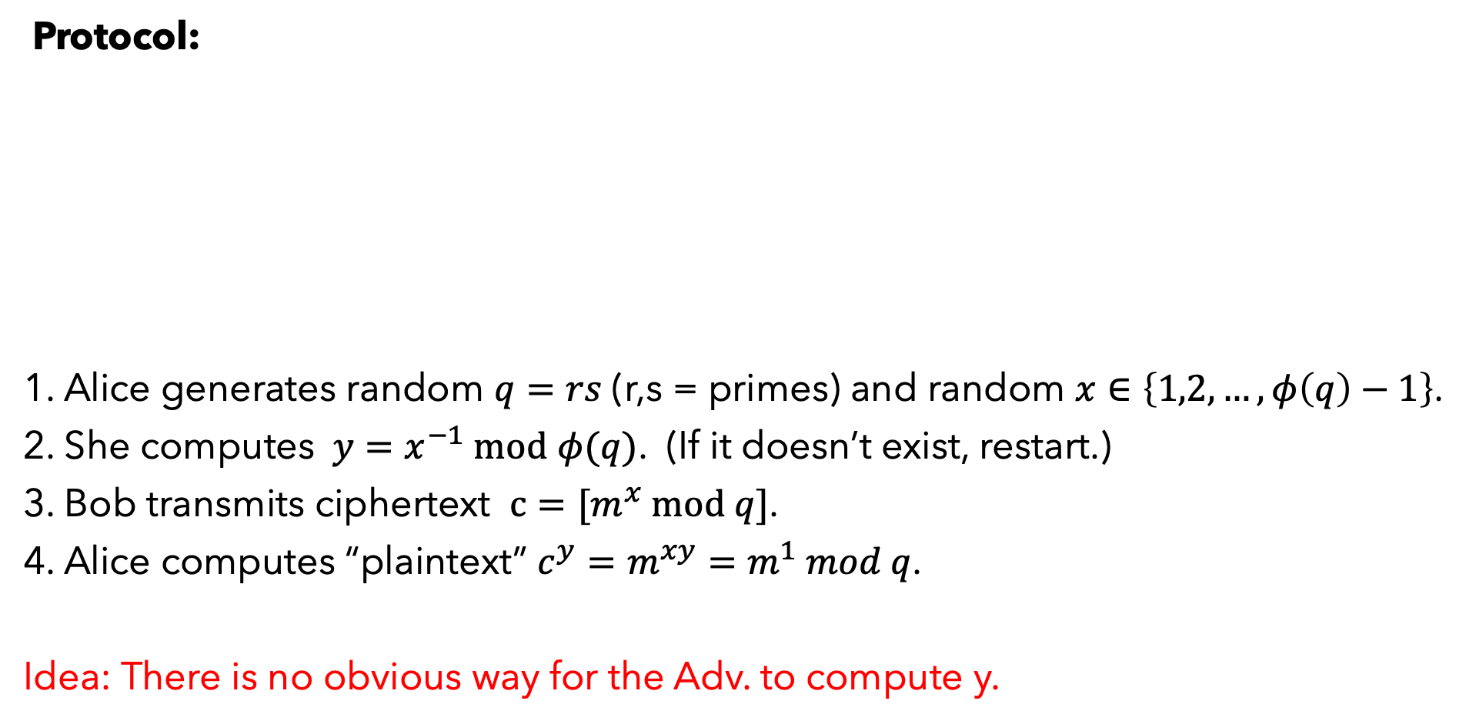


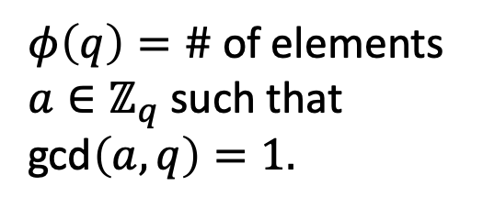

RECAP: A TOY VERSION OF RSA ENCRYPTION
Protocol:
1. Alice generates random $q=rs$ (r,s = primes) and random $x∈\left\{1,2,…,φ\left(q\right)−1\right\}$.
2. She computes $y=x^{−1} mod$ $φ(q)$. (If it doesn’t exist, restart.)
3. Bob transmits ciphertext $c=[m^{x} mod q]$.
4. Alice computes “plaintext” $c^{y}=m^{xy}=m^{1} mod q$.
Idea: There is no obvious way for the Adv. to compute y.
Adversary
$$q,x$$
$$[m^{x} mod q]$$
$$q≔rs$$
$$message=m$$
$φ\left(q\right)=\#$ of elements $a∈ℤ_{q}$ such that gcd$\left(a,q\right)=1.$

Slide 4
PLAN FOR THIS WEEK
1. Diffie-Hellman key-exchange.
Formal models of public-key encryption.
RSA encryption revisited.
4. The impact of Shor’s algorithm on cryptography.
TODAY

Slide 5
DIFFIE-HELLMAN KEY EXCHANGE

Slide 6


SOME REMARKS ON MOTIVATION
With RSA, we used multiplication in $ℤ_{q}$ to build a cryptosystem. Why can’t we just use a different algebraic structure instead?
Today we’ll define a large class of algebraic structures (groups).
We’ll use them to define a cryptosystem (Diffie-Hellman) which is related to, but different from, RSA.
“$abstraction$:”
Merriam-Webster definition:
“the art or process of abstracting”
Well, that was helpful. Trying again:
$$“abstract:”$$
“expressing a quality apart from an object.”

Slide 7
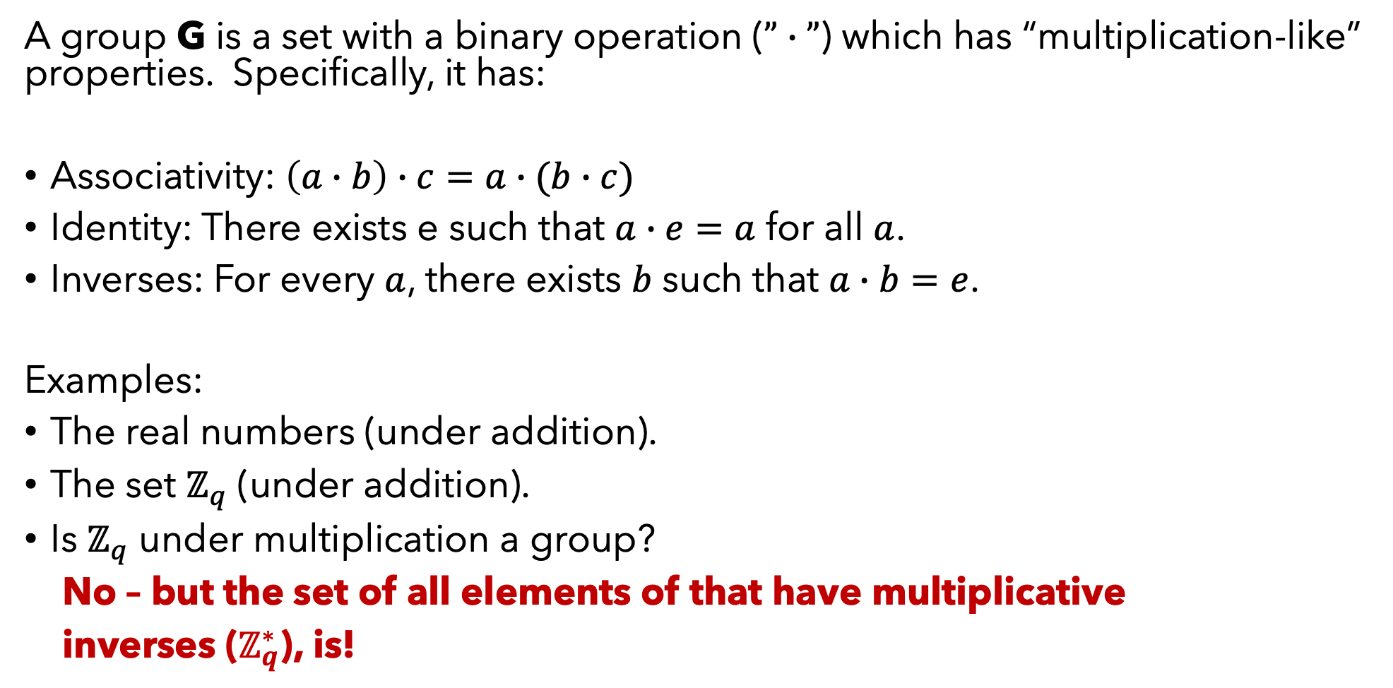
GROUPS
A group G is a set with a binary operation ($”∙”$) which has “multiplication-like” properties. Specifically, it has:
Associativity: $\left(a∙b\right)∙c=a∙(b∙c)$
Identity: There exists e such that $a∙e=a$ for all $a$.
Inverses: For every $a$, there exists $b$ such that $a∙b=e$.
Examples:
The real numbers (under addition).
The set $ℤ_{q}$ (under addition).
Is $ℤ_{q}$ under multiplication a group?
No – but the set of all elements of that have multiplicative
inverses ($ℤ_{q}^{∗}$), is!

Slide 8
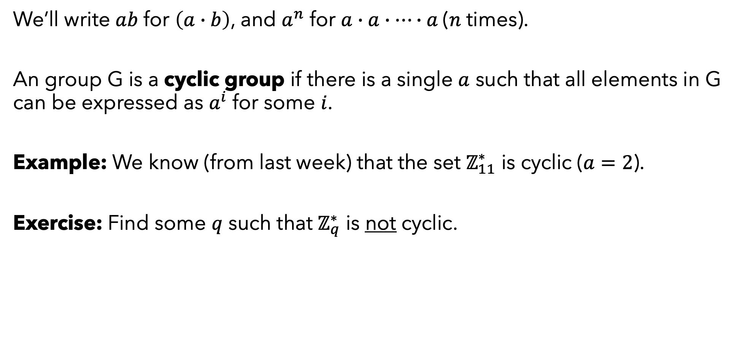
CYCLIC GROUPS
We’ll write $ab$ for $\left(a∙b\right)$, and $a^{n}$ for $a∙a∙…∙a$($n$ times).
An group G is a cyclic group if there is a single $a$ such that all elements in G can be expressed as $a^{i}$ for some $i$.
Example: We know (from last week) that the set $ℤ_{11}^{∗}$ is cyclic ($a=2$).
Exercise: Find some $q$ such that $ℤ_{q}^{∗}$ is not cyclic.

Slide 9


KEY EXCHANGE
In this paradigm, Alice and Bob are merely trying to generate a shared random key through public communication.
Adversary
$$k$$
$$k$$

Slide 10








DIFFIE-HELLMAN KEY EXCHANGE
Let G be a cyclic group, of size t, with generator g. (Public.)
Alice chooses random $x∈\{1,2,…,t\}$ and sends $g^{x}$ to Bob.
Bob chooses random $y∈\{1,2,…,t\}$ and sends $g^{y}$ to Alice.
Alice computes ${\left(g^{y}\right)}^{x}=g^{xy}.$ Bob computes ${\left(g^{x}\right)}^{y}=g^{xy}$.
They now have a shared secret!
Adversary
$g^{x}$
$x$
$g^{y}$
$y$
$g^{xy}$
$g^{xy}$
Exercise: Compute these values for $G=ℤ_{11}^{∗},$ g=2,x=3,y=4.

Slide 11
DIFFIE-HELLMAN KEY EXCHANGE
When is this protocol secure?
Better question: What would we have to assume in order to make this secure?
Adversary
$g^{x}$
$x$
$g^{y}$
$y$
$g^{xy}$
$g^{xy}$

Slide 12
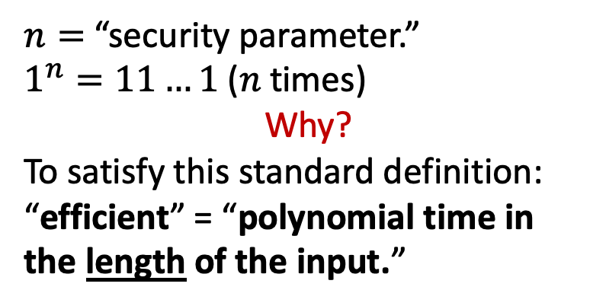

THE DECISIONAL DIFFIE-HELLMAN PROBLEM
Let G be an oracle that, on input $1^{n}$, generates a cyclic group (G,q). ($t$ := size of $G$.)
$n=$ “security parameter.”
$1^{n}=11…1$ ($n$ times)
Why?
To satisfy this standard definition:
“efficient” = “polynomial time in
the length of the input.”

Slide 13





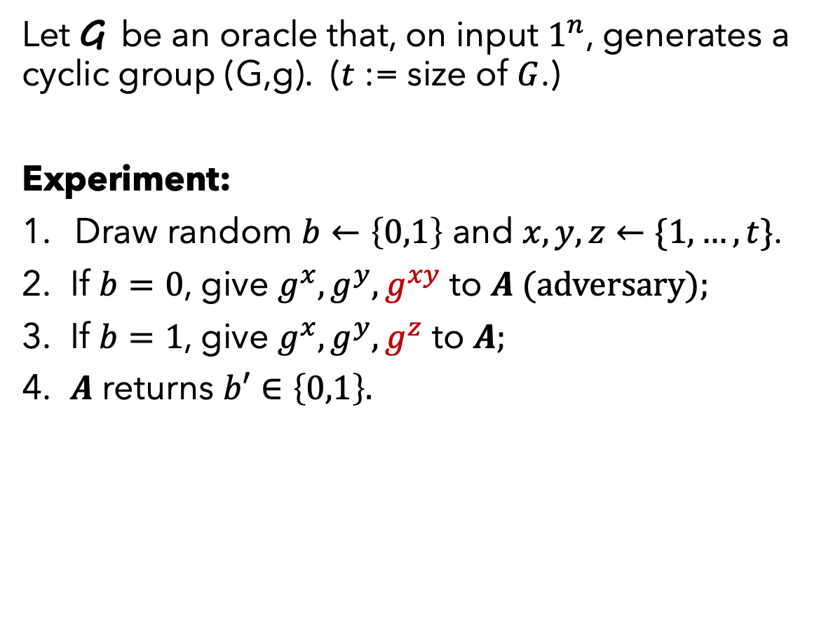







THE DECISIONAL DIFFIE-HELLMAN PROBLEM
Let G be an oracle that, on input $1^{n}$, generates a cyclic group (G,g). ($t$ := size of $G$.)
Experiment:
Draw random $b←\left\{0,1\right\}$ and $x,y,z←\{1,…,t\}$.
If $b=0$, give $g^{x}, g^{y}, g^{xy}$ to $A (adversary);$
If $b=1$, give $g^{x}, g^{y}, g^{z}$ to $A;$
$A$ returns $b′∈\left\{0,1\right\}.$
$$b=0$$
$$g^{x}$$
$$A$$
$$g^{y}$$
$$b′$$
$$g^{xy}$$
$$g^{x}$$
$$A$$
$$g^{y}$$
$$b′$$
$$g^{z}$$
$$b=1$$
Definition. The DDH problem is hard relative to G if, for any PPT $A$,
$$| Pr\left[A=1|b=0\right]−\operatorname{Pr}\left[A=1 | b=1\right]|≤negl\left(n\right).$$

Slide 14

DIFFIE-HELLMAN KEY EXCHANGE
Chapter 10 proves that if the DDH problem is hard, then the Diffie-Hellman Key Exchange protocol is secure (short proof).
Although the only group we’ve really worked with so far is $ℤ_{q}^{∗}$, DH can be done with other groups (such as elliptic curves, subsection 8.3.4).

Slide 15
FORMAL MODELS OF PUBLIC-KEY ENCRYPTION

Slide 16
PHILOSOPHY
We want to show that our cryptosystems are secure in a wide range of scenarios.
Therefore, we set up an “experiment,” giving the adversary a lot of power in attempting to break the cryptosystem, and ask whether it is still secure.
The adversary always has:
Polynomial-time computation ability.
Full knowledge of protocol design.
Access to all public information.
In some circumstances, we give the adversary even more freedom.

Slide 17

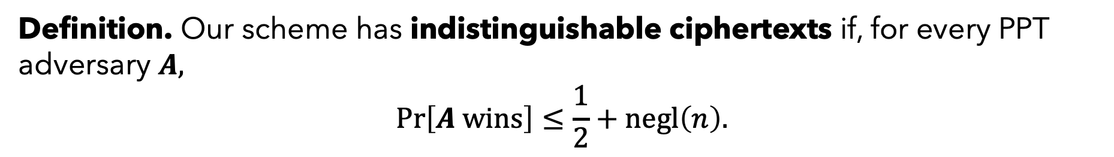








RECALL: “IND” SECURITY FOR SECRET KEY ENCRYPTION
Say our secret-key protocol is $\left(KeyGen, Enc, Dec\right)$.
Indistinguishability experiment (IND).
Sample $k←KeyGen$ and $b←\left\{0,1\right\};$
$A$ outputs two equal-length messages $m_{0},m_{1}$;
Give $A$ the ciphertext $c←Enc_{k}\left(m_{b}\right);$
$A$outputs a bit $b′$.
We say $A$wins if $b=b′$.
$$A$$
$$m_{0}$$
$$c$$
$$A$$
$$c$$
$$Enc_{k}\left(m_{b}\right)$$
$$m_{1}$$
$$b′$$
Definition. Our scheme has indistinguishable ciphertexts if, for every PPT adversary $A,$
$$\operatorname{Pr}\left[A wins\right]≤\frac{1}{2}+negl\left(n\right).$$

Slide 18
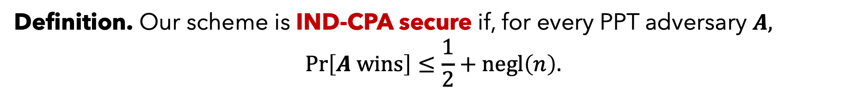



RECALL: IND-CPA SECURITY FOR SECRET KEY ENCRYPTION
We give A access to $Enc_{k}$ (as an oracle).
Indistinguishability experiment (IND).
Sample $k←KeyGen$ and $b←\left\{0,1\right\};$
$A$ outputs two equal-length messages $m_{0},m_{1}$;
Give $A$ the ciphertext $c←Enc_{k}\left(m_{b}\right);$
$A$outputs a bit $b′$.
We say $A$wins if $b=b′$.
$${Enc}_{k}$$
$${Enc}_{k}$$
$$A$$
$$m_{0}$$
$$c$$
$$A$$
$$c$$
$$Enc_{k}\left(m_{b}\right)$$
$$m_{1}$$
$$b′$$
Definition. Our scheme is IND-CPA secure if, for every PPT adversary $A,$
$$\operatorname{Pr}\left[A wins\right]≤\frac{1}{2}+negl\left(n\right).$$

Slide 19

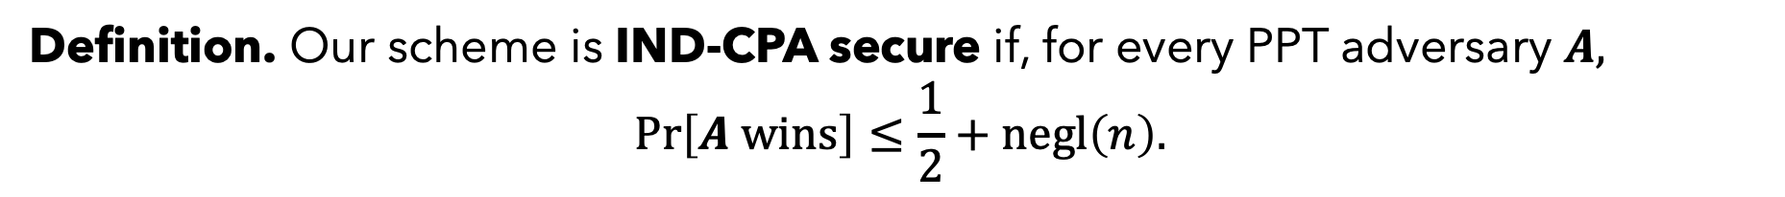



IND-CPA SECURITY FOR PUBLIC KEY ENCRYPTION
We give A the public key.
Indistinguishability experiment (IND).
Sample $pk,sk←KeyGen$ and $b←\left\{0,1\right\};$
$A$ outputs two equal-length messages $m_{0},m_{1}$;
Give $A$ the ciphertext $c←Enc_{k}\left(m_{b}\right);$
$A$outputs a bit $b′$.
We say $A$wins if $b=b′$.
Question: Why doesn’t this strategy always win?:
$A$ computes $Enc_{pk}\left(m_{0}\right)$. If it’s equal to c she returns $b^{′}=0$; otherwise, $b^{′}=1$.
Answer: $Enc$ may use randomness and may encrypt $m_{0}$ in multiple ways.
$$A$$
$$m_{0}$$
$$c$$
$$A$$
$$c$$
$$Enc_{pk}\left(m_{b}\right)$$
$$m_{1}$$
$$pk$$
$$b′$$
Definition. Our scheme is IND-CPA secure if, for every PPT adversary $A,$
$$\operatorname{Pr}\left[A wins\right]≤\frac{1}{2}+negl\left(n\right).$$

Slide 20
PHILOSOPHY (CONTINUED)
The nuances of the experiment matter.
Sometimes different experiments turn out to be equivalent. Sometimes, not.
CPA = ”chosen plaintext attack”
CCA = “chosen ciphertext attack”

Slide 21

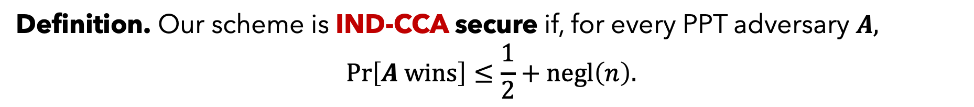




IND-CCA SECURITY FOR PUBLIC KEY ENCRYPTION
$${Dec}_{k}$$
(input $≠c$)
A has access to a decryption oracle.
Sample $pk,sk←KeyGen$ and $b←\left\{0,1\right\};$
Give$pk$ to $A$, who returns equal-length
messages $m_{0},m_{1}$;
Give $A$the ciphertext $c←Enc_{k}\left(m_{b}\right);$
4. $A$outputs a bit $b′$.
(A is not allowed to decrypt c.)
$${Dec}_{k}$$
$$A$$
$$m_{0}$$
$$c$$
$$A$$
$$c$$
$$Enc_{pk}\left(m_{b}\right)$$
$$m_{1}$$
$$pk$$
$$b′$$
Definition. Our scheme is IND-CCA secure if, for every PPT adversary $A,$
$$\operatorname{Pr}\left[A wins\right]≤\frac{1}{2}+negl\left(n\right).$$

Slide 22


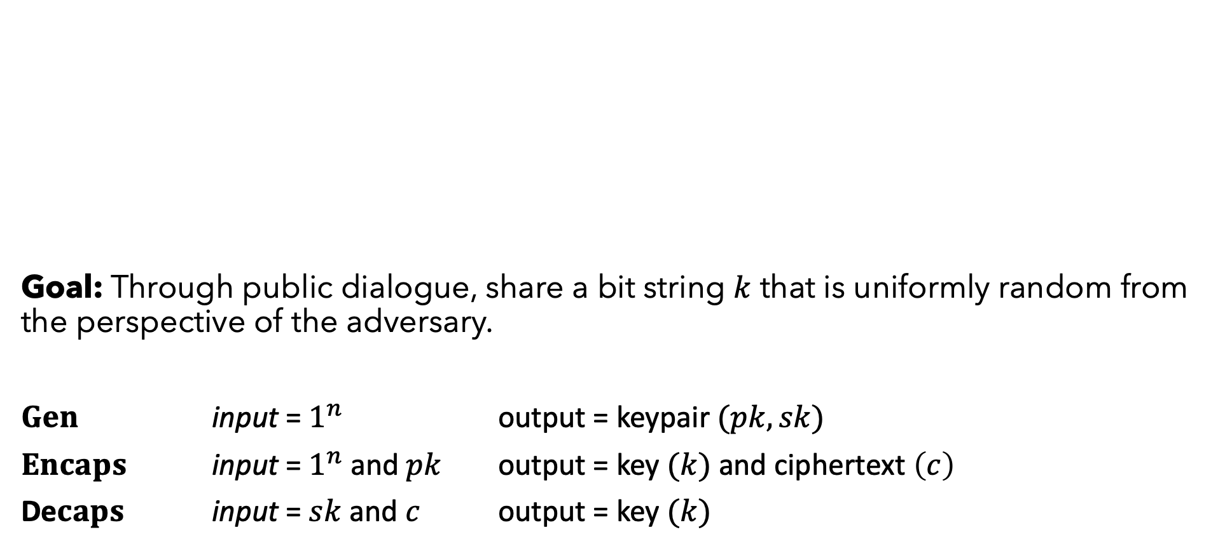



NEW TASK: KEY ENCAPSULATION
Goal: Through public dialogue, share a bit string $k$ that is uniformly random from the perspective of the adversary.
$Gen$ input = $1^{n}$ output = keypair $(pk,sk)$
$Encaps$ input = $1^{n}$ and $pk$ output = key $(k)$ and ciphertext $\left(c\right)$
De$caps$ input = $sk$ and $c$ output = key $(k)$
$$pk$$
$$c$$
$$sk$$
$$k$$
$$k$$

Slide 23

NEW TASK: KEY ENCAPSULATION
KEM = “key encapsulation mechanism”
One can do KEM $→$ secret-key encryption. The effect is similar to public-key encryption, and can be more efficient.
$$pk$$
$$c$$
$$sk$$
$$k$$
$$k$$

Slide 24








CPA SECURITY FOR KEMs
Carry out the KEM to obtain$pk,sk,c,k;$
Draw random $b←\left\{0,1\right\};$
If $b=0$, give $k, c, pk$ to $A;$
If $b=1$, generate a uniformly random bit string $u$ (same length$)$ and give $u, c, pk$ to $A;$
$A$ returns $b′$.
We say that $A$ “wins” if $b=b′$.
$$b=0$$
$$k$$
$$A$$
$$pk$$
$$b′$$
$$c$$
$$u$$
$$A$$
$$pk$$
$$b′$$
$$c$$
$$b=1$$
Definition. The scheme is CPA secure if, for every PPT adversary $A,$
$$\operatorname{Pr}\left[A wins\right]≤\frac{1}{2}+negl\left(n\right).$$

Slide 25
SUMMING UP
We “abstracted” the underlying hardness of RSA encryption, and defined the concept of a “group.”
We defined Diffie-Hellman key exchange (a general framework).
We stated various formal definitions of security for public-key encryption.
Coming up: A deeper look at RSA.

