Slide 1
MATH/CMSC 456 :: UPDATED COURSE INFO
Instructor: Gorjan Alagic (galagic@umd.edu)
Guest instructor: Carl Miller (camiller@umd.edu), ATL 3100K
Textbook: Introduction to Modern Cryptography, Katz and Lindell;
Webpage: alagic.org/cmsc-456-cryptography-spring-2020/
Piazza: piazza.com/umd/spring2020/cmsc456
ELMS: active, slides and reading posted there, homework 3 due midnight Thursday.
Gradescope: active, access through ELMS.
TAs (Our spot: shared open area across from AVW 4166)
Elijah Grubb (egrubb@cs.umd.edu) 11am-12pm TuTh (AVW);
Justin Hontz (jhontz@terpmail.umd.edu) 1pm-2pm MW (AVW);
Additional help:
Chen Bai (cbai1@terpmail.umd.edu) 3:30-5:30pm Tu (2115 ATL – inside JQI)
Bibhusa Rawal (bibhusa@terpmail.umd.edu) 3:30-5:30pm Th (2115 ATL – inside JQI)
Current readings:
Feb 25: pp. 285-297
Feb 27: pp. 302-324 (skip subsections 8.2.2 and 8.2.5)
Notes:
Classroom Support: 301-405-2500

Slide 2


RECAP: Secret-key vs. Public-key cryptography
A MAC (Message Authentication Code) is an example of secret-key cryptography.
Alice uses the secret key k to authenticate a message, which is then verified by Bob.
Limitations:
- Alice & Bob have to find a way to exchange the key k secretly.
- Any party that can verify an authentication code can also forge one!
Eve
Alice
$k$
Bob
$k$

Slide 3


RECAP: Secret-key vs. Public-key cryptography
In public-key cryptography, Alice creates a public key (pk) and a secret key (sk).
The public key is broadcast – anyone can know it.
Desired properties:
- Alice can sign a message in such way that her signature can be verified, but not forged, using pk.
- Anyone who has pk can encrypt, but not decrypt, a message to Alice.
We always want to make our protocol computationally easy to carry out, and computationally difficult for an adversary to break.
Eve
Alice
$sk$
Bob
$pk$

Slide 4

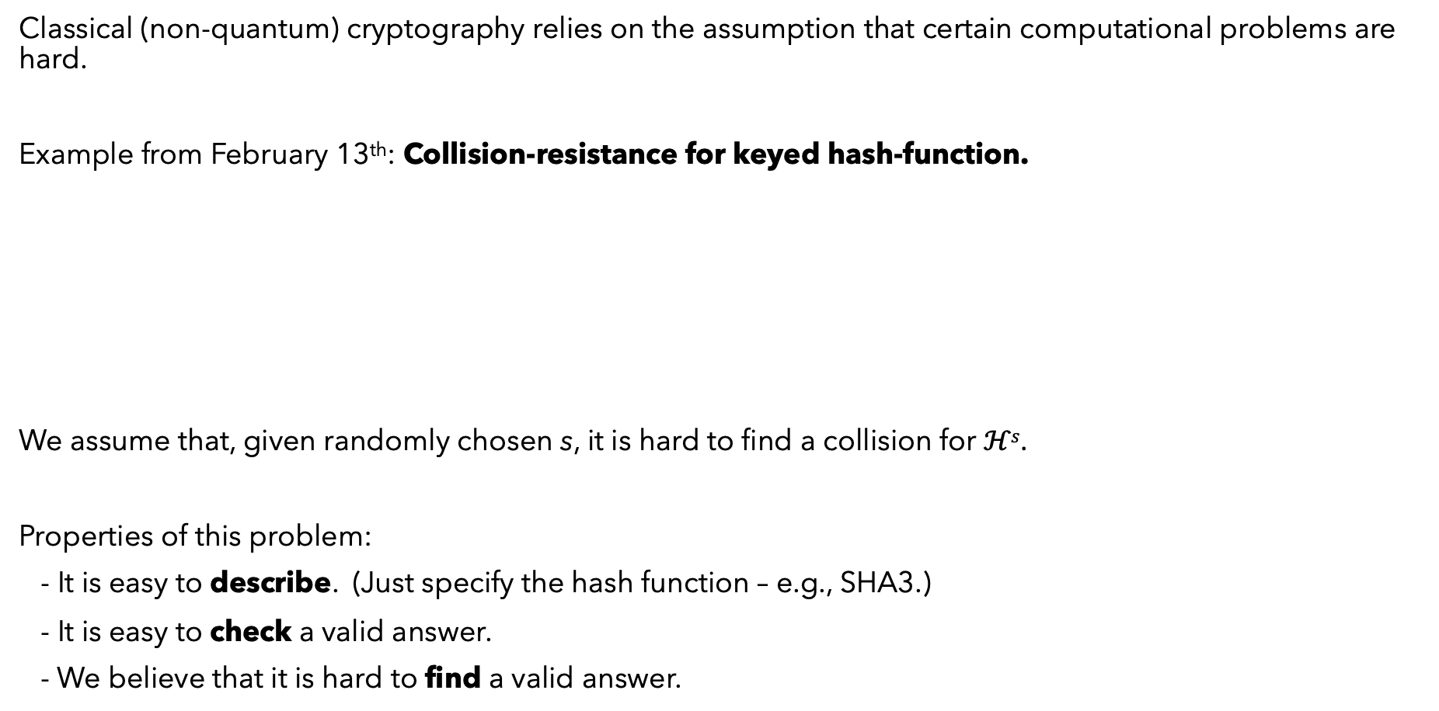




COMPUTATIONALLY DIFFICULT PROBLEMS
Classical (non-quantum) cryptography relies on the assumption that certain computational problems are hard.
Example from February 13th: Collision-resistance for keyed hash-function.
We assume that, given randomly chosen s, it is hard to find a collision for $ℋs$.
Properties of this problem:
- It is easy to describe. (Just specify the hash function – e.g., SHA3.)
- It is easy to check a valid answer.
- We believe that it is hard to find a valid answer.
$$x$$
$$x′$$
$$ℋs$$
$$ℋs$$
$$y$$

Slide 5

COMPUTATIONALLY DIFFICULT PROBLEMS
How about factoring numbers?
Problem: Suppose that n is a positive integer (expressed as a string of bits). Express n as
$n=p_{1}∙p_{2}∙p_{3}∙⋯∙p_{r},$
where each $p_{i}$ is prime (i.e., has no factors other than 1 and itself).
It is easy to check a factorization (in time less than a polynomial function of the number of bits).
However, no polynomial-time, non-quantum algorithm for factoring numbers is currently known.
The Plan:
1. Do a detailed study of some basic number theory.
2. Build a public-key cryptosystem based on the hardness of factoring.

Slide 6
MODULAR ARITHMETIC: Notation & Examples

Slide 7
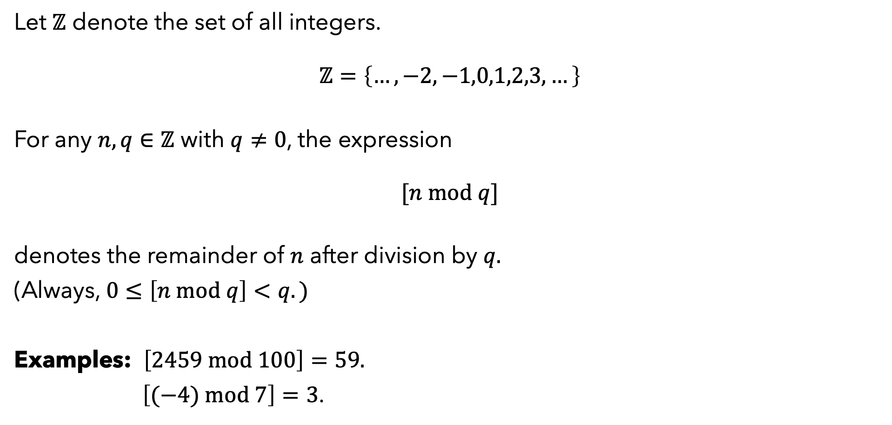
ARITHMETIC: THE BEGINNING
Let $ℤ$ denote the set of all integers.
$$ℤ=\left\{…,−2,−1,0,1,2,3,…\right\}$$
For any $n,q∈ℤ$ with $q≠0$, the expression
$$[n mod q]$$
denotes the remainder of $n$ after division by $q.$
(Always, $0≤\left[n mod q\right]<q.)$
Examples: $\left[2459 mod 100\right]=59.$
$\left[(−4) mod 7\right]=3$.
“Consider thyself to be dead, and to have completed thy life up to the present time; and live according to nature the remainder which is allowed thee.”
- Marcus Aurelius

Slide 8


ARITHMETIC: THE BEGINNING
Let $ℤ_{q}$ denote the set.
$$ℤ_{q}=\left\{0,1,2,3,…,q−1\right\}$$
For any $a,b∈$ $ℤ_{q}$, the elements
$$[(a+b) mod q]$$
$[\left(a∙b\right) mod q$]
are also elements of $ℤ_{q}$.
Example: $\left[\left(31∙8\right) mod 100\right]=\left[248 mod 100\right]=48.$
$$Alternative notation:$$
If $n,m$ are integers, then
$$n=m mod q$$
means
$\left[n mod q\right]=[m mod q]$.

Slide 9

ARITHMETIC: THE BEGINNING
Also, for any $a∈$ $ℤ_{q}$ and $n>0$, the integer
$$[a^{n} mod q]$$
is an element of $ℤ_{q}$.
Trick: When carrying out multiple operations, you can mod out as you go.
$$[\left(2∙3∙4∙4\right) mod 5]$$
$$=\left[\left(6∙16\right) mod 5\right]$$
$$=\left[\left(1∙1\right) mod 5\right]$$
$$=1$$

Slide 10
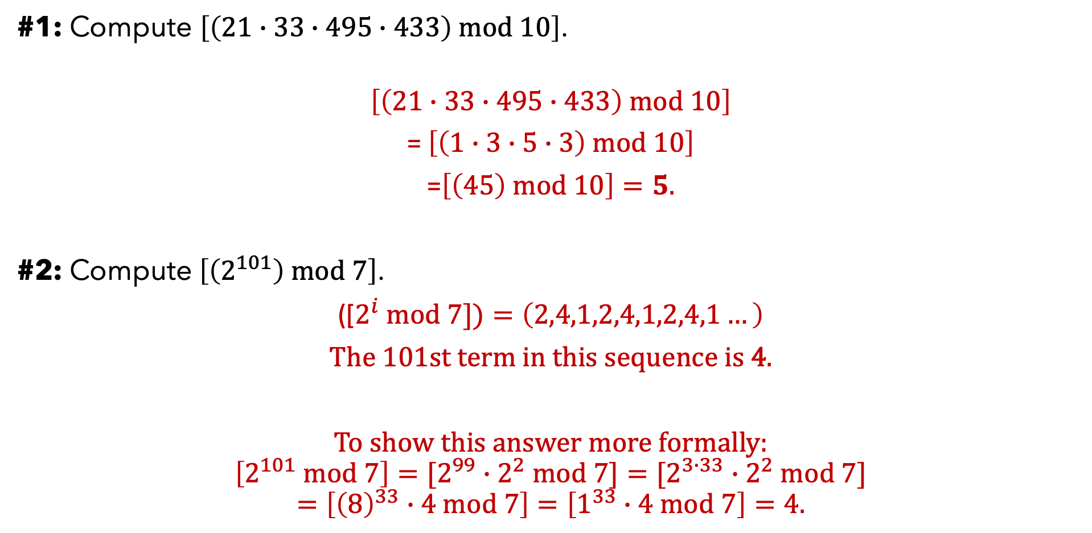
TWO EXERCISES (no calculators!)
#1: Compute $\left[\left(21∙33∙495∙433\right) mod 10\right]$.
$$\left[\left(21∙33∙495∙433\right) mod 10\right]$$
= $\left[\left(1∙3∙5∙3\right) mod 10\right]$
=$\left[\left(45\right) mod 10\right]=5.$
#2: Compute $\left[\left(2^{101}\right) mod 7\right]$.
([$2^{i} mod 7])=\left(2,4,1,2,4,1,2,4,1…\right)$
The 101st term in this sequence is 4.
To show this answer more formally:
$$\left[2^{101} mod 7\right]=[2^{99}∙2^{2} mod 7]=[2^{3∙33}∙2^{2} mod 7]$$
$$=\left[{\left(8\right)}^{33}∙4 mod 7\right]=\left[1^{33}∙4 mod 7\right]=4.$$

Slide 11

ADDITION AND MULTIPLICATION IN $ℤ_{q}$
Let $f:$ $ℤ_{9}→ ℤ_{9}$ be the function defined by $f\left(a\right)=\left[\left(a+4\right) mod 9\right].$
$f\left(0\right)=4$
$f\left(1\right)=5$
$f\left(2\right)=6$
$f\left(3\right)=7$
$f\left(4\right)=8$
$f\left(5\right)=0$
$f\left(6\right)=1$
$f\left(7\right)=2$
$f\left(8\right)=3$

Slide 12

ADDITION AND MULTIPLICATION IN $ℤ_{q}$
Let $f:$ $ℤ_{9}→ ℤ_{9}$ be the function defined by $f\left(a\right)=\left[\left(a+5\right) mod 9\right].$
$f\left(0\right)=5$
$f\left(1\right)=6$
$f\left(2\right)=7$
$f\left(3\right)=8$
$f\left(4\right)=0$
$f\left(5\right)=1$
$f\left(6\right)=2$
$f\left(7\right)=3$
$f\left(8\right)=4$

Slide 13

ADDITION AND MULTIPLICATION IN $ℤ_{q}$
Let $f:$ $ℤ_{9}→ ℤ_{9}$ be the function defined by $f\left(a\right)=[\left(4a\right) mod 9].$
$f\left(0\right)=0$
$f\left(1\right)=4$
$f\left(2\right)=8$
$f\left(3\right)=3$
$f\left(4\right)=7$
$f\left(5\right)=2$
$f\left(6\right)=6$
$f\left(7\right)=1$
$f\left(8\right)=5$

Slide 14


ADDITION AND MULTIPLICATION IN $ℤ_{q}$
Let $f:$ $ℤ_{9}→ ℤ_{9}$ be the function defined by $f\left(a\right)=[\left(5a\right) mod 9].$
$f\left(0\right)=0$
$f\left(1\right)=5$
$f\left(2\right)=1$
$f\left(3\right)=6$
$f\left(4\right)=2$
$f\left(5\right)=7$
$f\left(6\right)=3$
$f\left(7\right)=8$
$f\left(8\right)=4$
Note: No repeats! Why?
The map $g:ℤ_{9}→ ℤ_{9}$ defined by $g\left(a\right)=\left[\left(2a\right) mod 9\right]$ satisfies
$$g\left(f\left(a\right)\right)=\left[2∙5∙a mod 9\right]$$
$$=[1∙a mod 9]$$
$$=a.$$
That means f is a one-to-one function.
Since $\left[2∙5 mod 9\right]=1,$ we say that 2 is the multiplicative inverse of 5 mod 9. We write:
$$2=5^{−1} mod 9.$$

Slide 15

ADDITION AND MULTIPLICATION IN $ℤ_{q}$
Let $f:$ $ℤ_{9}→ ℤ_{9}$ be the function defined by $f\left(a\right)=[\left(3a\right) mod 9].$
$f\left(0\right)=0$
$f\left(1\right)=3$
$f\left(2\right)=6$
$f\left(3\right)=0$
$f\left(4\right)=3$
$f\left(5\right)=6$
$f\left(6\right)=0$
$f\left(7\right)=3$
$f\left(8\right)=6$
This is not a one-to-one function.
Q: When is multiplication one-to-one?

Slide 16


EXPONENTIATION IN $ℤ_{q}$
Let $f:\{0,1,2,…\}→ ℤ_{9}$ be the function defined by $f\left(a\right)=[2^{a} mod 9].$
$f\left(0\right)=1$
$f\left(1\right)=2$
$f\left(2\right)=4$
$f\left(3\right)=8$
$f\left(4\right)=7$
$f\left(5\right)=5$
$f\left(6\right)=1$
$f\left(7\right)=2$
$f\left(8\right)=4$
…
This is a periodic function.
$f\left(a+6\right)=f(a)$.
Repeat.

Slide 17

EXPONENTIATION IN $ℤ_{q}$
Let $f:$ $\{0,1,2,…\}→ ℤ_{9}$ be the function defined by $f\left(a\right)=[6^{a} mod 9].$
$f\left(0\right)=1$
$f\left(1\right)=6$
$f\left(2\right)=0$
$f\left(3\right)=0$
$f\left(4\right)=0$
$f\left(5\right)=0$
$f\left(6\right)=0$
$f\left(7\right)=0$
$f\left(8\right)=0$
…
This is not a periodic function.
Why is exponentiation periodic for some bases and not for others?

Slide 18
MODULAR ARITHMETIC: Proofs

Slide 19
COMMENTS ABOUT PROOFS
A proof is a series of deductions based on clearly stated assumptions.
Everything must be justified, unless it’s an assumption, or it’s obvious.
Conclusion
What’s obvious? If in doubt, ask.
Assumption #1
Assumption #2

Slide 20

A PROPOSITION ABOUT MULTIPLICATIVE INVERSES
Proposition: Let $q$ be a positive integer. Let $a$ be an element of $ℤ_{q},$ and suppose that $a$ has a multiplicative inverse in $ℤ_{q}.$ Then, the function $f:$ $ℤ_{q}→ℤ_{q}$ defined by
$$f\left(x\right)=[ax mod q]$$
is a one-to-one function.

Slide 21
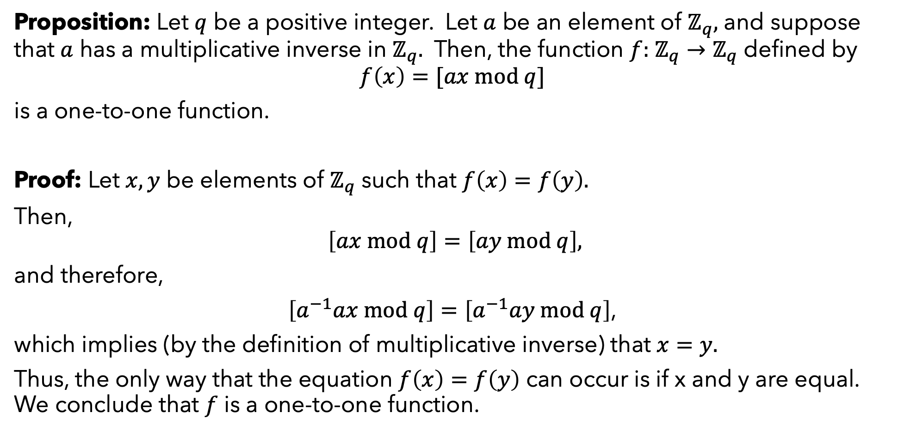
A PROPOSITION ABOUT MULTIPLICATIVE INVERSES
Proposition: Let $q$ be a positive integer. Let $a$ be an element of $ℤ_{q},$ and suppose that $a$ has a multiplicative inverse in $ℤ_{q}.$ Then, the function $f:$ $ℤ_{q}→ℤ_{q}$ defined by
$$f\left(x\right)=[ax mod q]$$
is a one-to-one function.
Proof: Let $x,y$ be elements of $ℤ_{q}$ such that $f\left(x\right)=f\left(y\right).$
Then,
$$\left[ax mod q\right]=\left[ay mod q\right],$$
and therefore,
$\left[a^{−1}ax mod q\right]=\left[a^{−1}ay mod q\right]$,
which implies (by the definition of multiplicative inverse) that $x=y.$
Thus, the only way that the equation $f\left(x\right)=f\left(y\right)$ can occur is if x and y are equal. We conclude that $f$ is a one-to-one function.

Slide 22
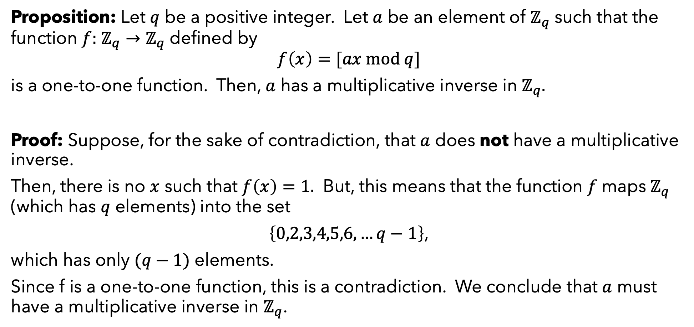
ANOTHER PROPOSITION ABOUT MULTIPLICATIVE INVERSES
Proposition: Let $q$ be a positive integer. Let $a$ be an element of $ℤ_{q}$ such that the function $f:$ $ℤ_{q}→ℤ_{q}$ defined by
$$f\left(x\right)=[ax mod q]$$
is a one-to-one function. Then, $a$ has a multiplicative inverse in $ℤ_{q}.$
Proof: Suppose, for the sake of contradiction, that $a$ does not have a multiplicative inverse.
Then, there is no $x$ such that $f\left(x\right)=1.$ But, this means that the function $f$maps${ ℤ}_{q}$ (which has $q$ elements) into the set
$\left\{0,2,3,4,5,6,…q−1\right\}$,
which has only $(q−1)$ elements.
Since f is a one-to-one function, this is a contradiction. We conclude that $a$ must have a multiplicative inverse in $ℤ_{q}$.

Slide 23
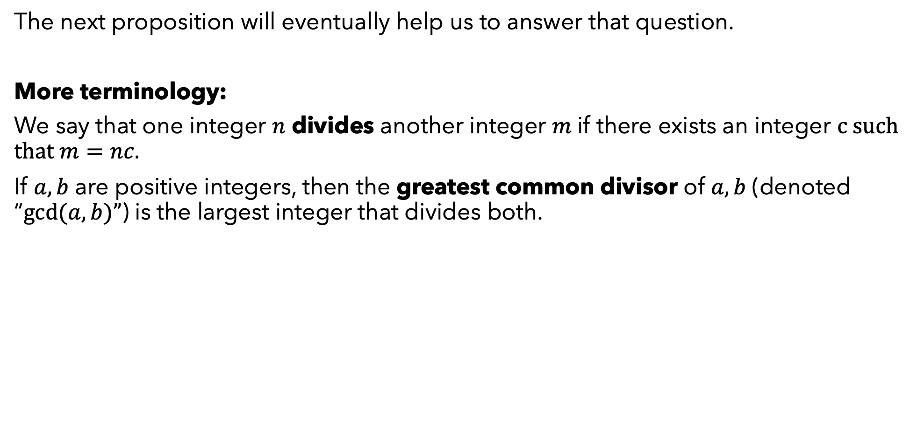
A FUNDAMENTAL PROPOSITION
Question: Which elements of $ℤ_{q}$ have multiplicative inverses?
The next proposition will eventually help us to answer that question.
More terminology:
We say that one integer $n$ divides another integer $m$if there exists an integer $c$such that $m=nc.$
If $a,b$ are positive integers, then the greatest common divisor of $a,b$ (denoted “$gcd⁡(a,b)”$) is the largest integer that divides both.

Slide 24
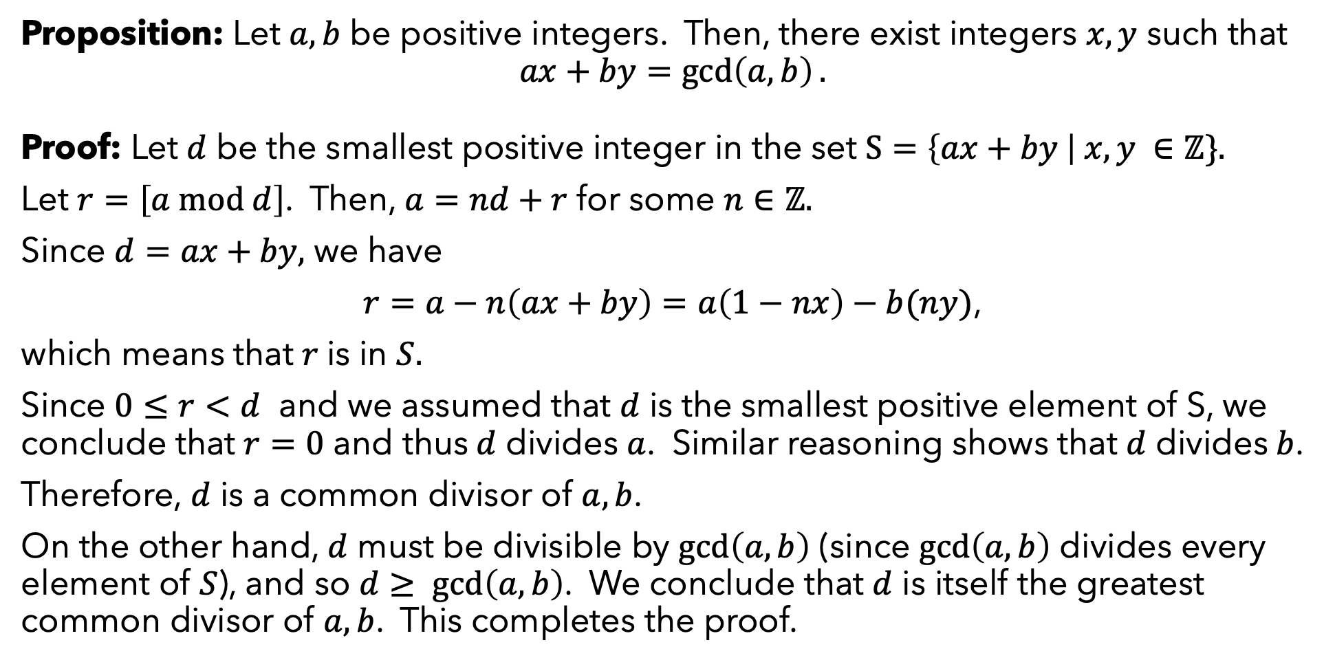
A FUNDAMENTAL PROPOSITION
Proposition: Let $a,b$ be positive integers. Then, there exist integers $x,y$ such that
$$ax+by=\gcd\left(a,b\right).$$
Proof: Let $d$ be the smallest positive integer in the set $S=\left\{ax+by \right| x,y ∈ℤ\}.$
Let $r=\left[a mod d\right]$. Then, $a=nd+r$ for some $n∈ℤ.$
Since $d=ax+by,$ we have
$r=a−n\left(ax+by\right)=a\left(1−nx\right)−b(ny)$,
which means that $r$is in $S.$
Since $0≤r<d$ and we assumed that $d$ is the smallest positive element of S, we conclude that $r=0$ and thus$d$ divides $a$. Similar reasoning shows that $d$ divides$b$.
Therefore, $d$ is a common divisor of $a,b$.
On the other hand, $d$ must be divisible by $\gcd\left(a,b\right)$ (since $\gcd\left(a,b\right)$ divides every element of $S$), and so $d≥ \gcd\left(a,b\right)$. We conclude that $d$ is itself the greatest common divisor of $a,b$. This completes the proof.

Slide 25
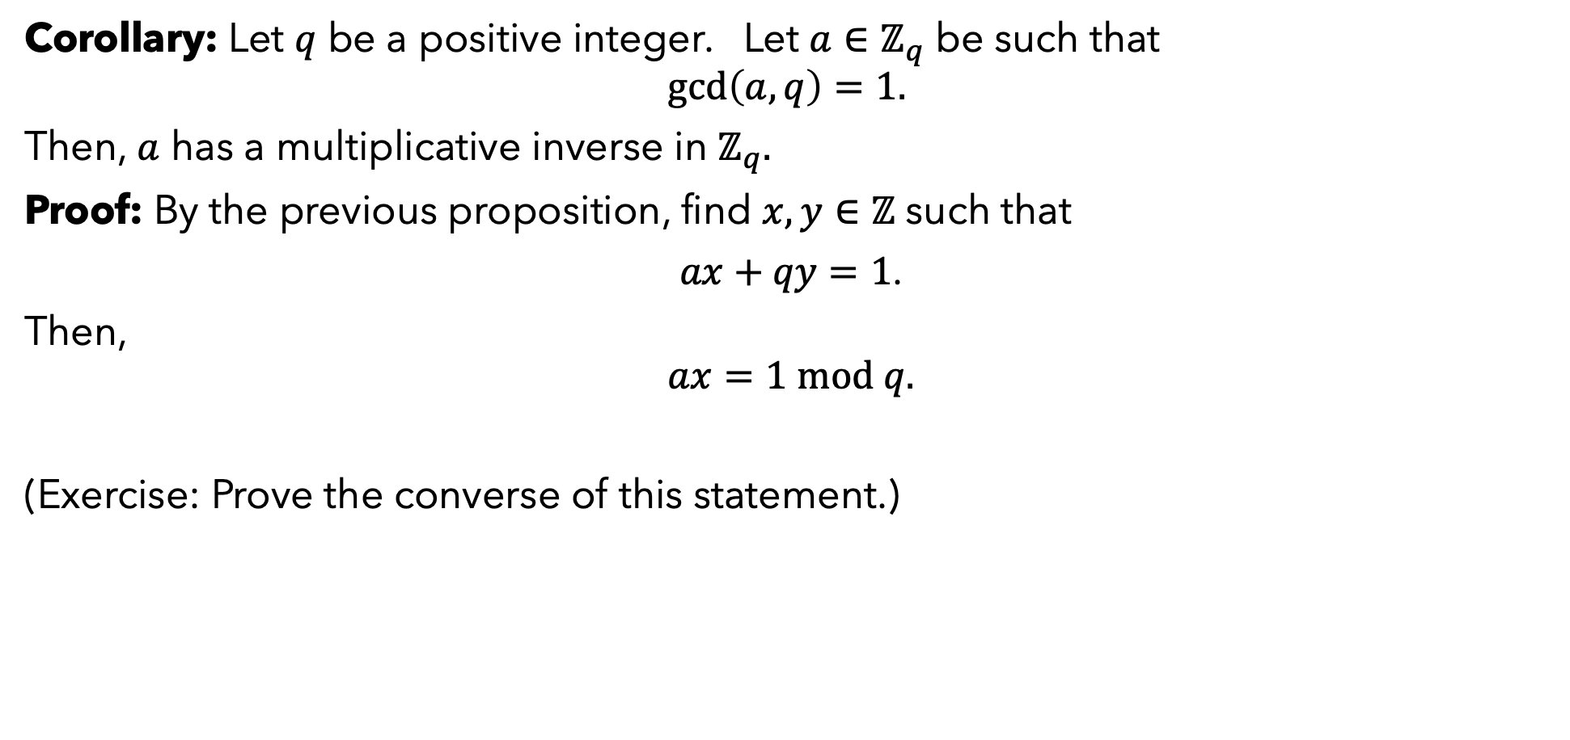
A CRITERION FOR MULTIPLICATIVE INVERSES
Corollary: Let $q$ be a positive integer. Let $a∈ℤ_{q}$ be such that
$$\gcd\left(a,q\right)=1.$$
Then, $a$ has a multiplicative inverse in $ℤ_{q}.$
Proof: By the previous proposition, find $x,y∈ℤ$ such that
$ax+qy=1$.
Then,
$$ax=1 mod q.$$
(Exercise: Prove the converse of this statement.)

Slide 26
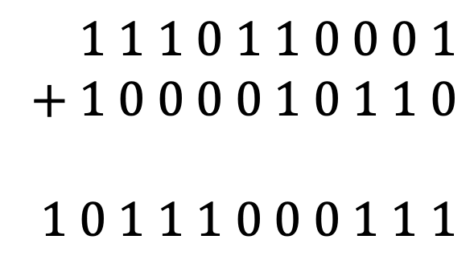
COMMENTS ABOUT COMPUTATION
We consider an operation to be efficient if it takes time that is polynomial in the length of its input.
(If the input is a sequence of integers, then its length is, approximately, the number of bits needed to represent those integers in base 2.)
So, addition is efficient:
So are multiplication and mod.
Can multiplicative inverses be computed efficiently?
Yes – Euclid’s algorithm. See appendix B.1.2.
$$1 1 1 0 1 1 0 0 0 1$$
$$+ 1 0 0 0 0 1 0 1 1 0$$
$$1 0 1 1 1 0 0 0 1 1 1$$

Slide 27
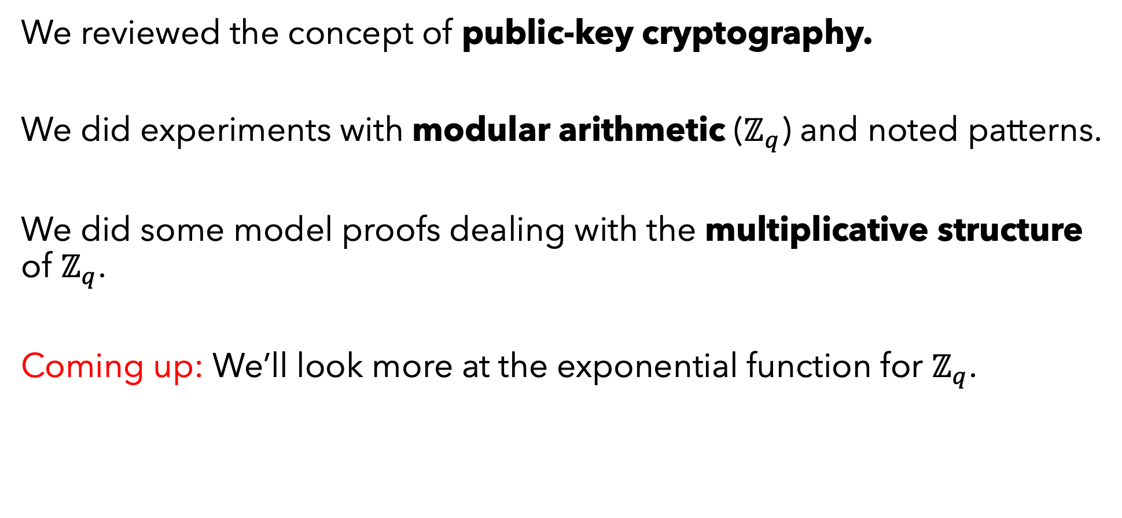
SUMMING UP
We reviewed the concept of public-key cryptography.
We did experiments with modular arithmetic ($ℤ_{q}$) and noted patterns.
We did some model proofs dealing with the multiplicative structure of $ℤ_{q}$.
Coming up: We’ll look more at the exponential function for $ℤ_{q}$.

