Slide 1
MATH/CMSC 456 :: UPDATED COURSE INFO
Instructor: Gorjan Alagic (galagic@umd.edu)
Guest instructor: Carl Miller (camiller@umd.edu), ATL 3100K
Textbook: Introduction to Modern Cryptography, Katz and Lindell;
Webpage: alagic.org/cmsc-456-cryptography-spring-2020/
Piazza: piazza.com/umd/spring2020/cmsc456
ELMS: active, slides and reading posted there.
Gradescope: active, access through ELMS.
TAs (Our spot: shared open area across from AVW 4166)
Elijah Grubb (egrubb@cs.umd.edu) 11am-12pm TuTh (AVW);
Justin Hontz (jhontz@terpmail.umd.edu) 1pm-2pm MW (AVW);
Additional help:
Chen Bai (cbai1@terpmail.umd.edu) 3:30-5:30pm Tu (2115 ATL – inside JQI)
Bibhusa Rawal (bibhusa@terpmail.umd.edu) 3:30-5:30pm Th (2115 ATL – inside JQI)
Homework 4 will be assigned next week, and due March 12.
Notes:
Classroom Support: 301-405-2500

Slide 2
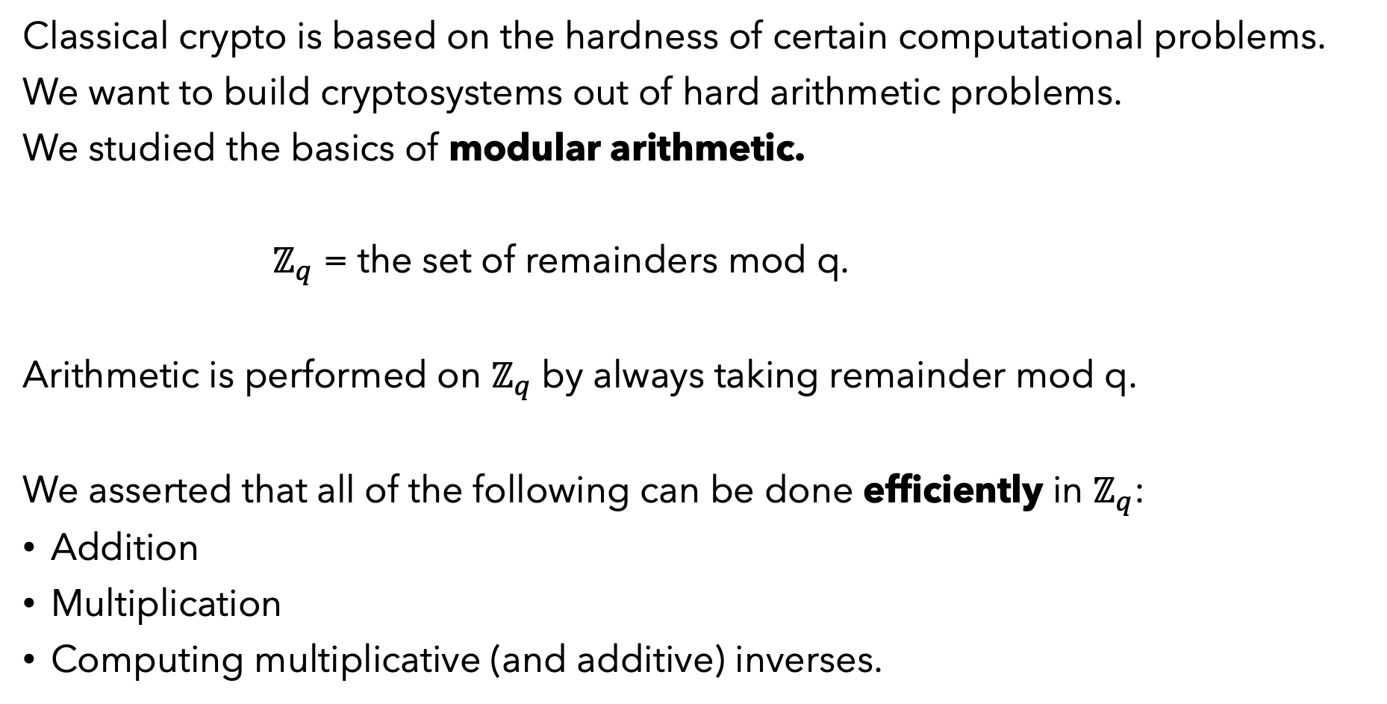
RECAP: Crypto and Arithmetic
Classical crypto is based on the hardness of certain computational problems.
We want to build cryptosystems out of hard arithmetic problems.
We studied the basics of modular arithmetic.
$ℤ_{q}$ = the set of remainders mod q.
Arithmetic is performed on $ℤ_{q}$ by always taking remainder mod q.
We asserted that all of the following can be done efficiently in $ℤ_{q}$:
Addition
Multiplication
Computing multiplicative (and additive) inverses.

Slide 3

PLAN FOR TODAY
Exhibit some needed efficient algorithms for arithmetic (exponentiation, and Euclid’s algorithm).
Study the behavior of the exponential function mod q.
Construct a toy cryptosystem.
Last time we talked about the hardness of the factoring problem:
$$n=p_{1}∙p_{2}∙p_{3}∙⋯∙p_{r}$$
We are going to base our toy cryptosystem on a different, closely related problem: inverting the exponential function mod n.

Slide 4

SOME EFFICIENT ALGORITHMS FOR ARITHMETIC IN $ℤ_{q}$
(APPENDIX B)

Slide 5

MODULAR ARITHMETIC (Review)
Let $ℤ_{q}$ denote the set.
$$ℤ_{q}=\left\{0,1,2,3,…,q−1\right\}$$
For any $a,b∈$ $ℤ_{q}$, the elements
$$[(a+b) mod q]$$
$[\left(a∙b\right) mod q$]
are also elements of $ℤ_{q}$.
For any $a∈$ $ℤ_{q}$ and $n≥0$, the integer
$$[a^{n} mod q]$$
is an element of $ℤ_{q}$.

Slide 6
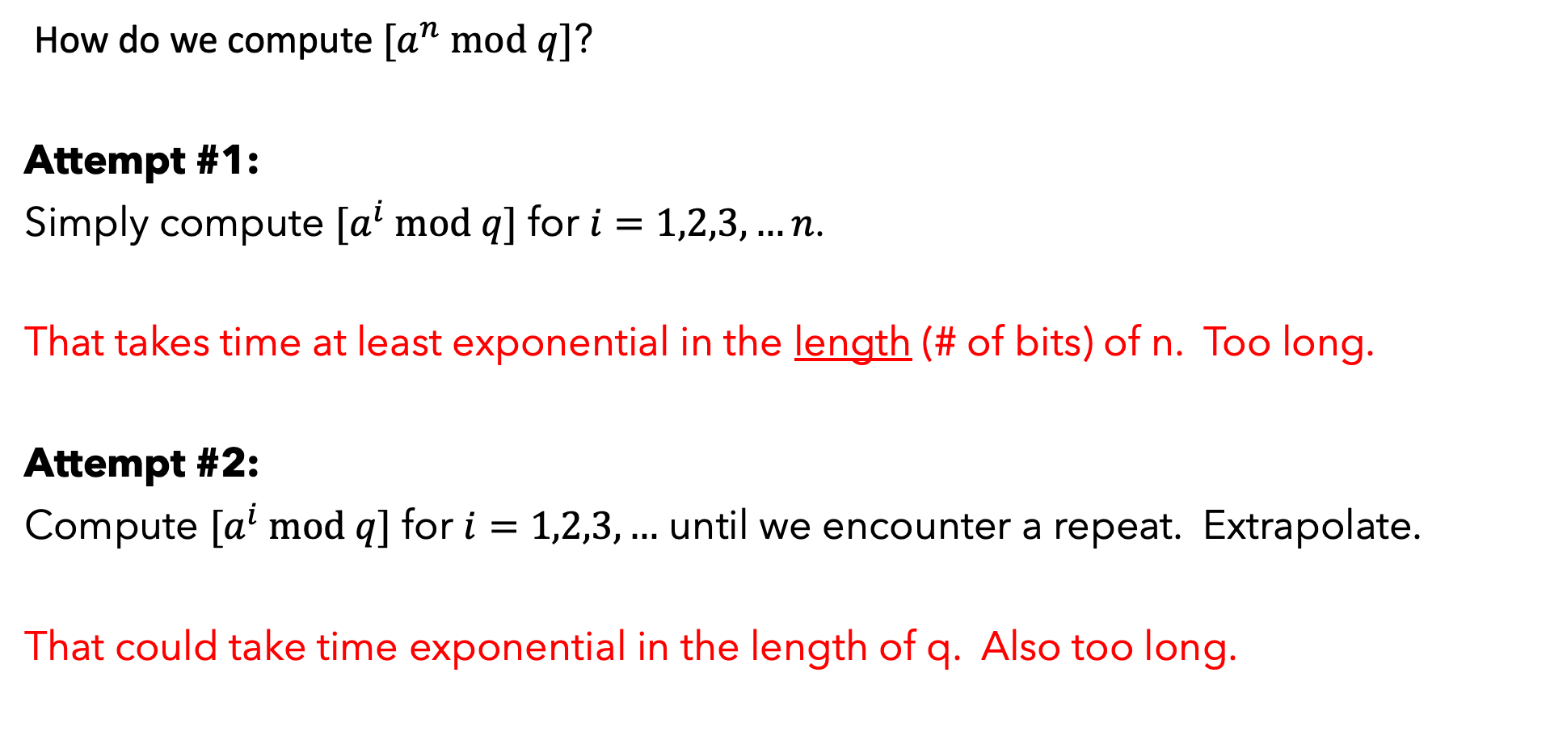
ALGORITHM FOR EXPONENTIATION
How do we compute $[a^{n} mod q]$?
Attempt #1:
Simply compute $[a^{i} mod q]$ for $i=1,2,3,…n$.
That takes time at least exponential in the length (# of bits) of n. Too long.
Attempt #2:
Compute $[a^{i} mod q]$ for $i=1,2,3,…$ until we encounter a repeat. Extrapolate.
That could take time exponential in the length of q. Also too long.

Slide 7
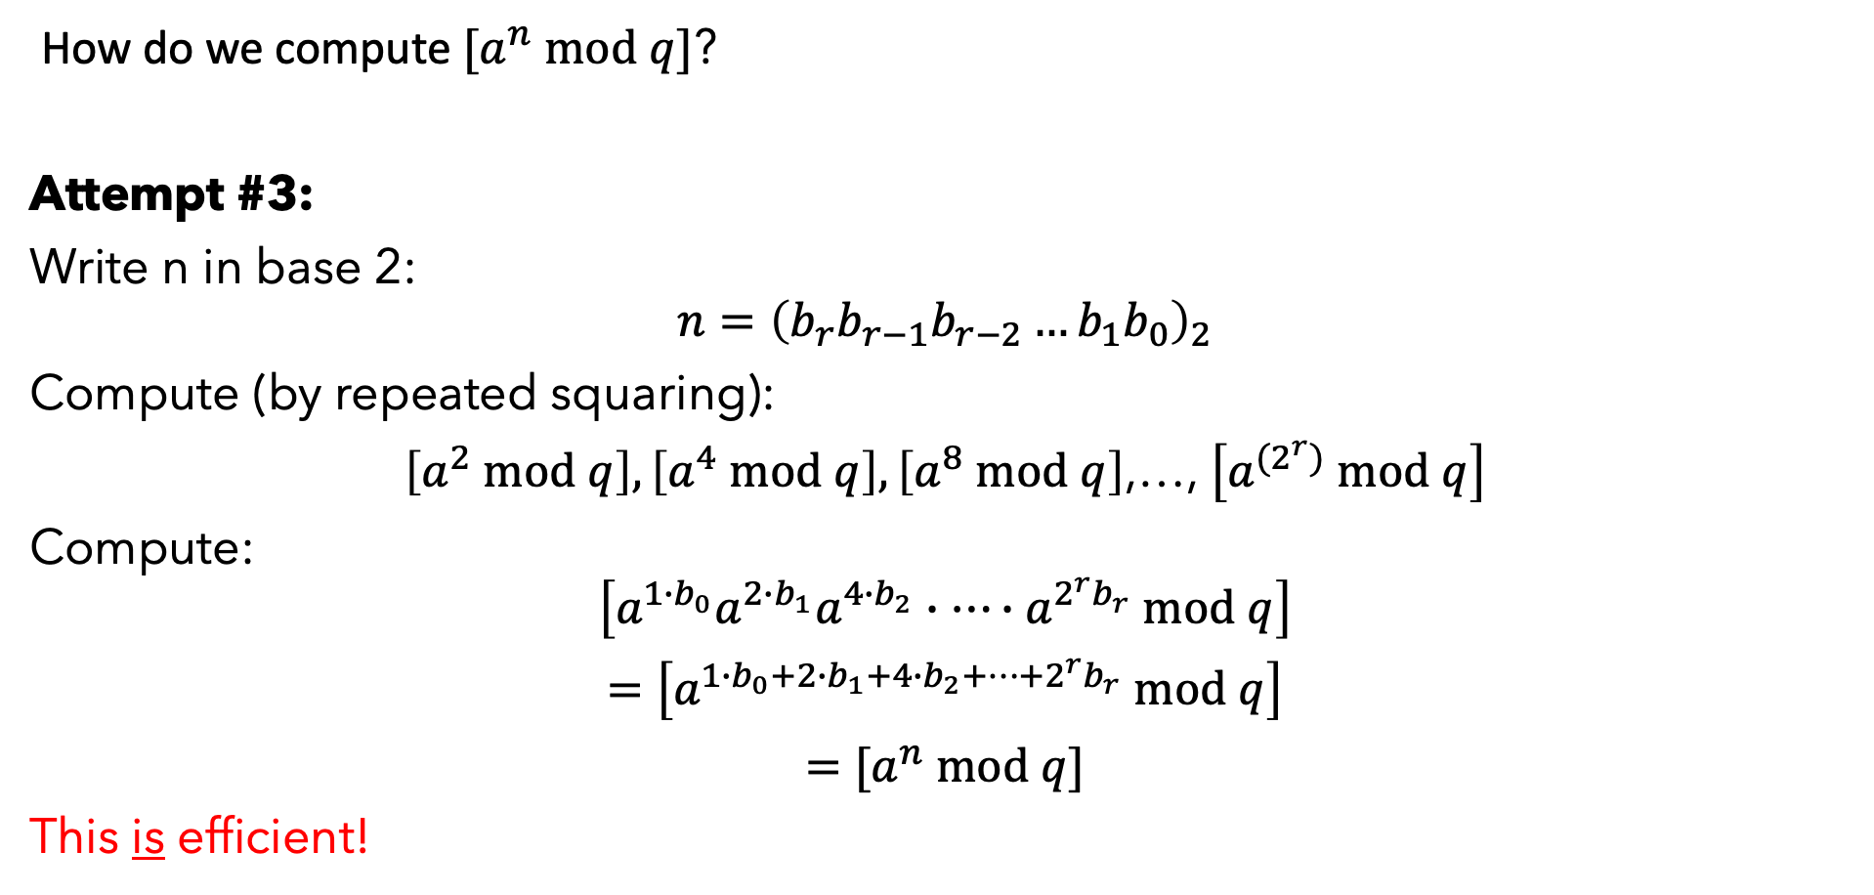
ALGORITHM FOR EXPONENTIATION
How do we compute $[a^{n} mod q]$?
Attempt #3:
Write n in base 2:
$$n={\left(b_{r}b_{r−1}b_{r−2}…b_{1}b_{0}\right)}_{2}$$
Compute (by repeated squaring):
$\left[a^{2} mod q\right],\left[a^{4} mod q\right],\left[a^{8} mod q\right]$,…, $\left[a^{{(2}^{r})} mod q\right]$
Compute:
$$\left[a^{1∙b_{0}}a^{2∙b_{1}}a^{4∙b_{2}}∙…∙a^{{2^{r}b}_{r}} mod q\right]$$
$=$ $\left[a^{1∙b_{0}+2∙b_{1}+4∙b_{2}+…+{2^{r}b}_{r}} mod q\right]$
$=$ $[a^{n} mod q]$
This is efficient!

Slide 8

ALGORITHM FOR EXPONENTIATION
Example:
Let $a=2$, $n=73$, $q=9$.
Then,
$$n={\left(1001001\right)}_{2}$$
By squaring,
$\left[a^{2} mod q\right]=4,\left[a^{4} mod q\right]=7,\left[a^{8} mod q\right]=4$, $\left[a^{16} mod q\right]=7,…$
Compute:
$$[a^{n} mod q]$$
$$=\left[a^{1}a^{8}a^{64} mod q\right]$$
$=$ $\left[2∙4∙7 mod q\right]$
$$=2.$$

Slide 9
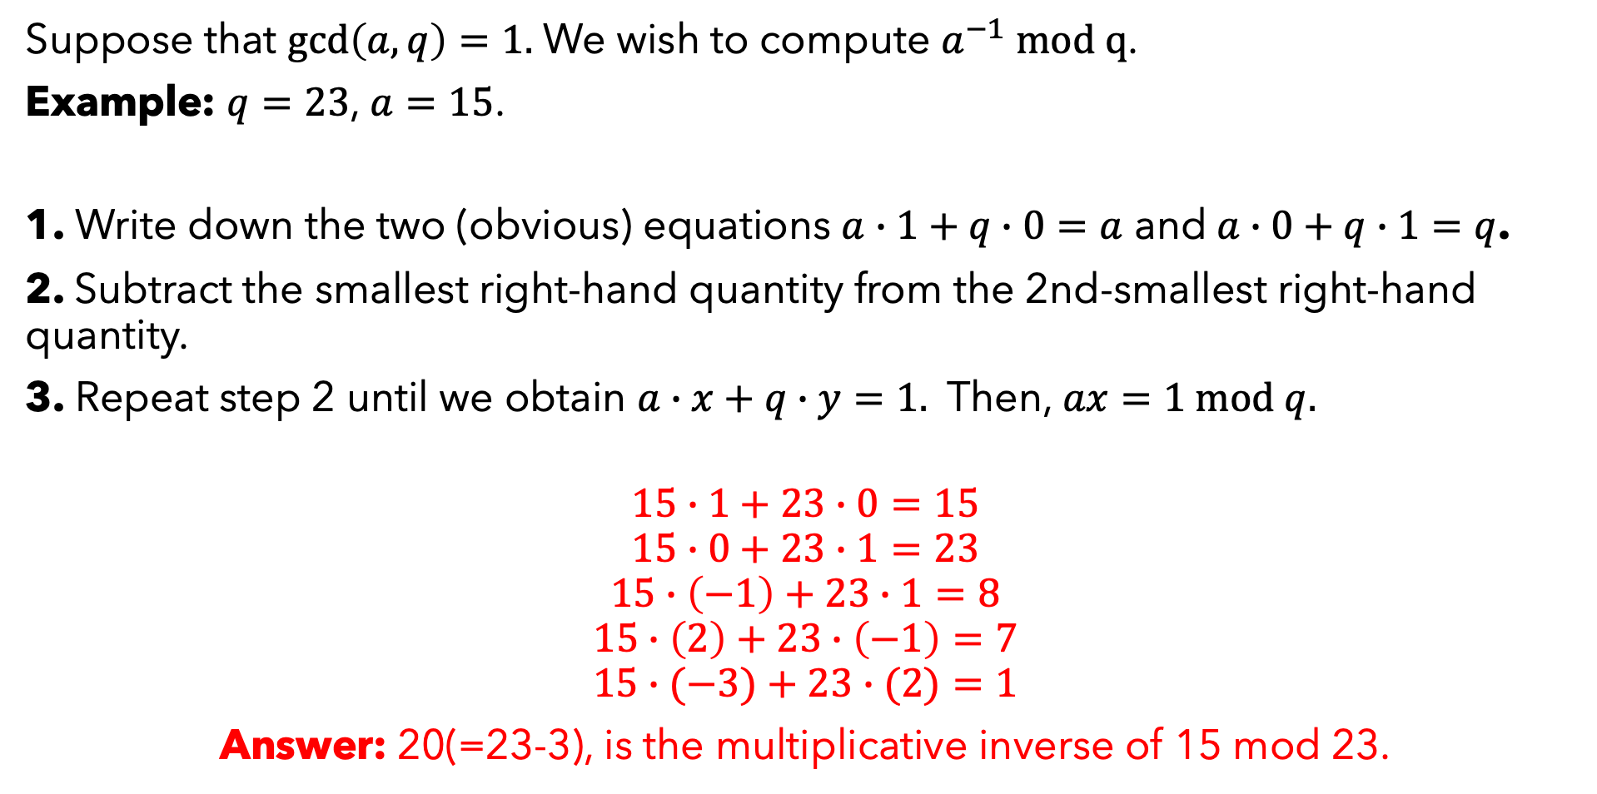
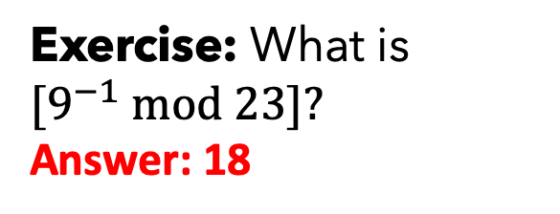
ALGORITHM FOR MULTIPLICATIVE INVERSES
Suppose that $\gcd\left(a,q\right)=1.$ We wish to compute $a^{−1} mod q$.
Example: $q=23$, $a=15$.
1. Write down the two (obvious) equations $a∙1+q∙0=a$ and $a∙0+q∙1=q$.
2. Subtract the smallest right-hand quantity from the 2nd-smallest right-hand quantity.
3. Repeat step 2 until we obtain $a∙x+q∙y=1.$ Then, $ax=1 mod q.$
$$15∙1+23∙0=15$$
$$15∙0+23∙1=23$$
$$15∙\left(−1\right)+23∙1=8$$
$$15∙\left(2\right)+23∙\left(−1\right)=7$$
$$15∙(−3)+23∙(2)=1$$
Answer: 20(=23-3), is the multiplicative inverse of 15 mod 23.
Exercise: What is ${[9}^{−1} mod 23]?$
Answer: 18

Slide 10

EFFICIENT OPERATIONS MOD q
Question: Given ${[a}^{n} mod q]$, $n, q$, can we efficiently compute $a$?
If not … perhaps we can use exponentiation to build a cryptosystem!
 | Efficient to compute? | Efficient to invert?
Addition | YES | YES
Multiplication | YES | YES
Exponentiation | YES | ????

Slide 11
THE BEHAVIOR OF THE EXPONENTIAL FUNCTION IN $ℤ_{q}$

Slide 12

EXERCISE (no calculators)
What is the period of the sequence
$\left[a^{0} mod 11\right],{[a}^{1} mod 11],{[a}^{2} mod 11],…$ ?
(Meaning, how often does it repeat?). Answer this for $a=2,4,5,10.$
Observation: All positive integers satisfy $a^{10}=1 mod 11.$

Slide 13
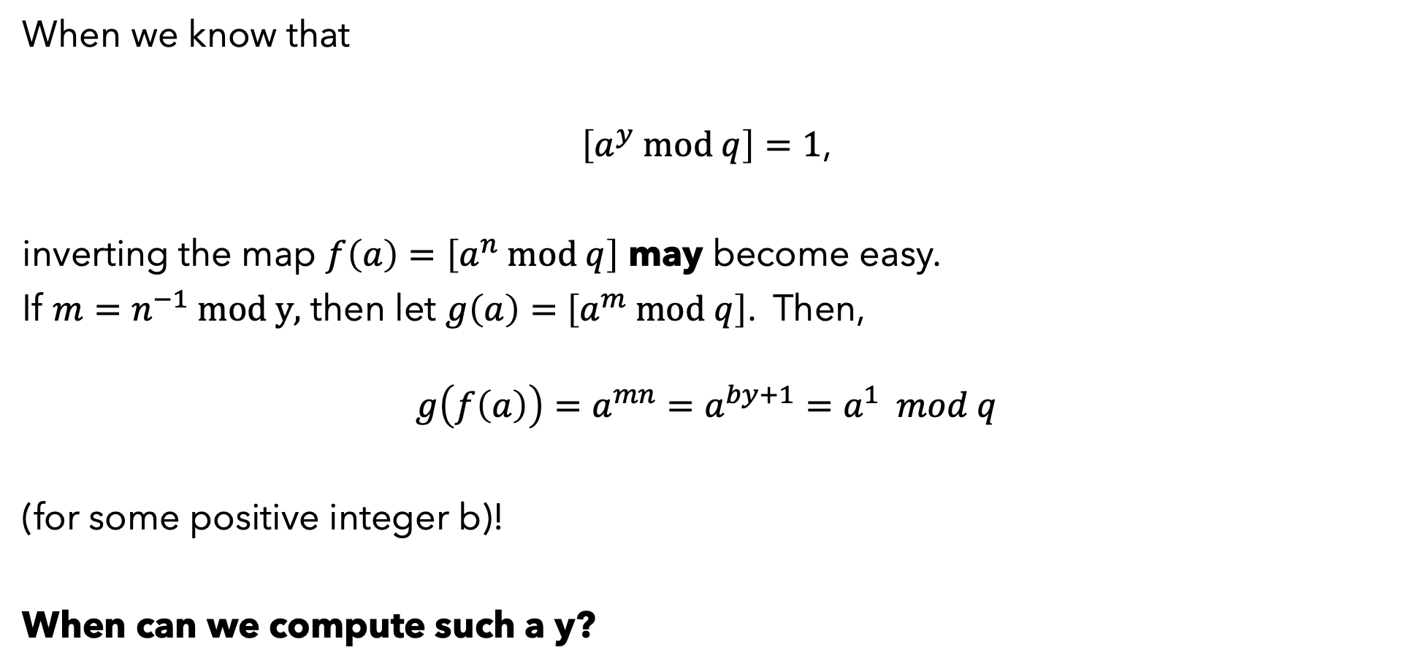
AN OBSERVATION
When we know that
$\left[a^{y} mod q\right]=1$,
inverting the map $f\left(a\right)=\left[a^{n} mod q\right]$ may become easy.
If $m=n^{−1} mod y,$ then let $g\left(a\right)=$ $\left[a^{m} mod q\right]$. Then,
$$g\left(f\left(a\right)\right)=a^{mn}=a^{by+1}=a^{1} mod q$$
(for some positive integer b)!
When can we compute such a y?

Slide 14
PRIME MODULI
Recall that a positive integer n > 1 is prime if it has no factors other than 1 and itself.
(Example: q=11 is prime!)
This is Fermat’s Little Theorem. How can we prove this?
Theorem: If q is prime, then for any $a∈\left\{1,2,…,q−1\right\},$
$a^{q−1}=1 mod q$.

Slide 15

PRIME MODULI
Theorem: If q is prime, then for any $a∈\left\{1,2,…,q−1\right\},$
$a^{q−1}=1 mod q$.
Lemma 1: The map $h:\left\{1,2,…,q−1\right\}→\{1,2,…,q−1\}$ given by
$$h\left(x\right)=[ax mod q]$$
is one-to-one and onto.
Proof of Lemma 1: Since q is prime, $\gcd\left(a,q\right)=1$. Thus, by a result from the previous lecture, $a$ has a multiplicative inverse mod q.
Let $g:\left\{1,2,…,q−1\right\}→\left\{1,2,…,q−1\right\}$ be defined by
$g\left(x\right)=[a^{−1}x mod q]$.
Then $g\left(h\left(x\right)\right)=h\left(g\left(x\right)\right)=x$, and so we conclude that h is one-to-one and onto.

Slide 16

PRIME MODULI
Theorem: If q is prime, then for any $a∈\left\{1,2,…,q−1\right\},$
$a^{q−1}=1 mod q$.
Lemma 2: Suppose that $x,y∈ℤ$and $b∈\left\{1,2,…,q−1\right\}$ are such that
$bx=by mod q$.
Then,
$x=y mod q$.
Proof of Lemma 2: Since q is prime, $\gcd\left(b,q\right)=1$, and $b$ has a multiplicative inverse mod q. We have
${x=b}^{−1}bx=b^{−1}by=y mod q$,
as desired.

Slide 17

PRIME MODULI
Theorem: If q is prime, then for any $a∈\left\{1,2,…,q−1\right\},$
$a^{q−1}=1 mod q$.
Proof of Theorem: Letting $h$ be the function from Lemma 1 (mult. by $a$), we have
$$\left\{1,2,…,q−1\right\}=\left\{h\left(1\right),h\left(2\right),…,h\left(q−1\right)\right\}.$$
Taking the products of both sets, we find that
$$1∙2∙⋯∙\left(q−1\right)=h(1)∙h(2)∙⋯∙h(q−1)$$
$$=\left(a\right)\left(2a\right)\left(3a\right)⋯[\left(q−1\right)a]$$
$=a^{q−1}∙$ $1∙2∙⋯∙\left(q−1\right) mod q$
Applying Lemma 2,
$1=a^{q−1} mod q$.

Slide 18
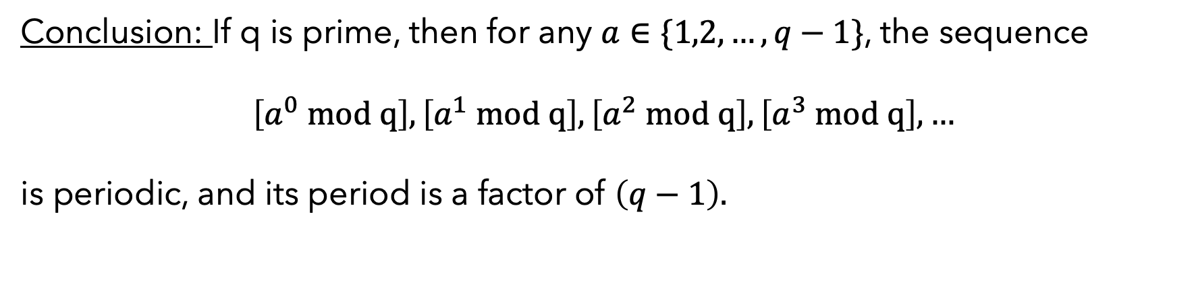
PRIME MODULI
Conclusion: If q is prime, then for any $a∈\{1,2,…,q−1\}$, the sequence
$$\left[a^{0} mod q\right],\left[a^{1} mod q\right], \left[a^{2} mod q\right], \left[a^{3} mod q\right], …$$
is periodic, and its period is a factor of $\left(q−1\right).$

Slide 19
A TOY CRYPTOSYSTEM (PUBLIC-KEY ENCRYPTION)

Slide 20



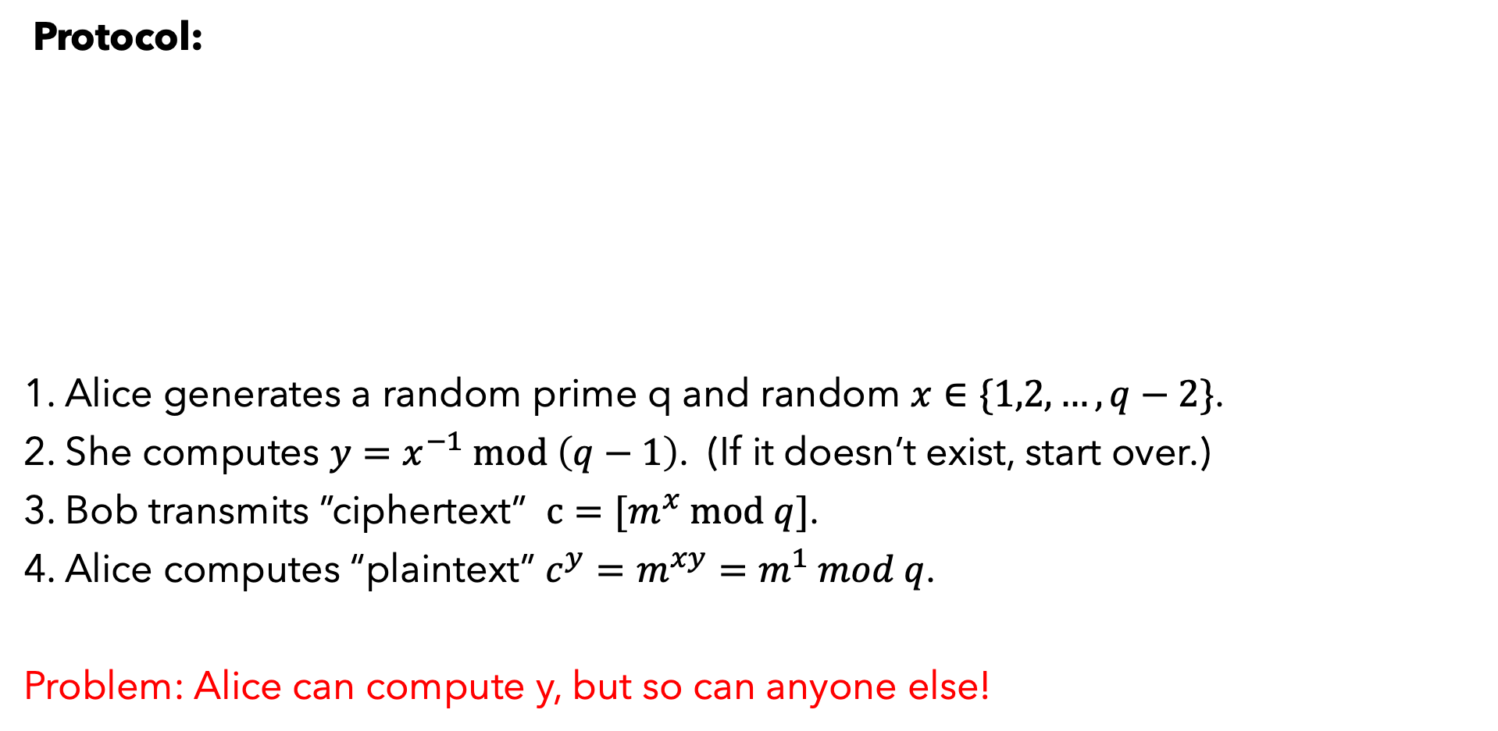


FIRST ATTEMPT
Protocol:
1. Alice generates a random prime q and random $x∈\{1,2,…,q−2\}$.
2. She computes $y=x^{−1} mod \left(q−1\right)$. (If it doesn’t exist, start over.)
3. Bob transmits ”ciphertext” $c=[m^{x} mod q]$.
4. Alice computes “plaintext” $c^{y}=m^{xy}=m^{1} mod q$.
Problem: Alice can compute y, but so can anyone else!
Eve
$$q,x$$
$$[m^{x} mod q]$$
$$message=m (<q)$$

Slide 21
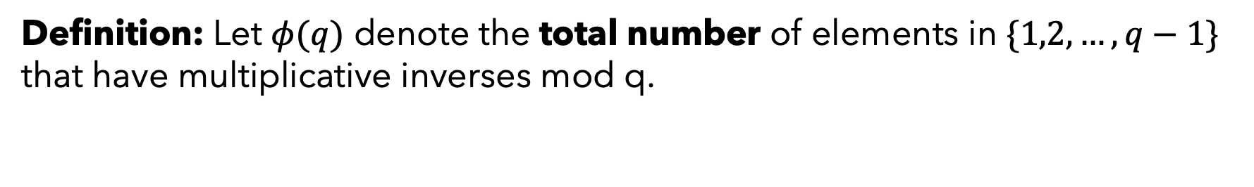
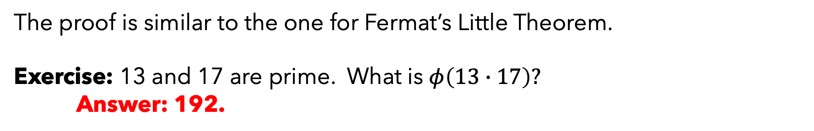
NON-PRIME MODULUS?
Suppose that q is not prime.
We wish to prove an analogue of Fermat’s Little Theorem.
Definition: Let $φ(q)$ denote the total number of elements in $\{1,2,…,q−1\}$ that have multiplicative inverses mod q.
Theorem: For any q>0 and any $a∈\left\{1,2,…,q−1\right\},$
$a^{φ(q)}=1 mod q$.
The proof is similar to the one for Fermat’s Little Theorem.
Exercise: 13 and 17 are prime. What is $φ\left(13∙17\right)?$
Answer: 192.

Slide 22
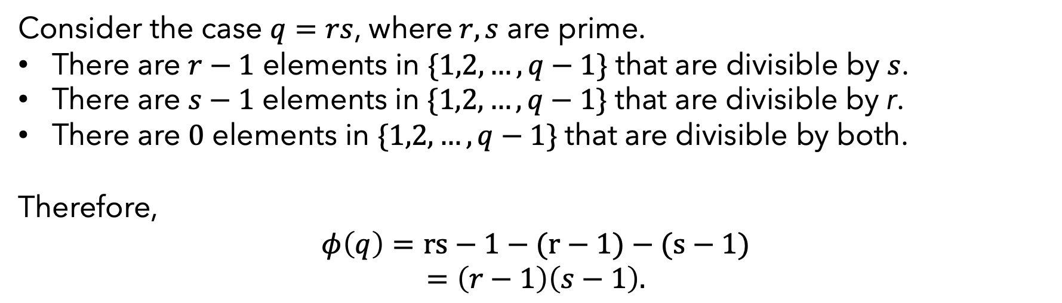
NON-PRIME MODULUS?
Consider the case $q=rs$, where$r,s$ are prime.
There are $r−1$ elements in $\{1,2,…,q−1\}$ that are divisible by $s$.
There are $s−1$ elements in $\{1,2,…,q−1\}$ that are divisible by r.
There are $0$ elements in $\{1,2,…,q−1\}$ that are divisible by both.
Therefore,
$$φ\left(q\right)=rs−1−(r−1)−(s−1)$$
$=\left(r−1\right)\left(s−1\right).$

Slide 23
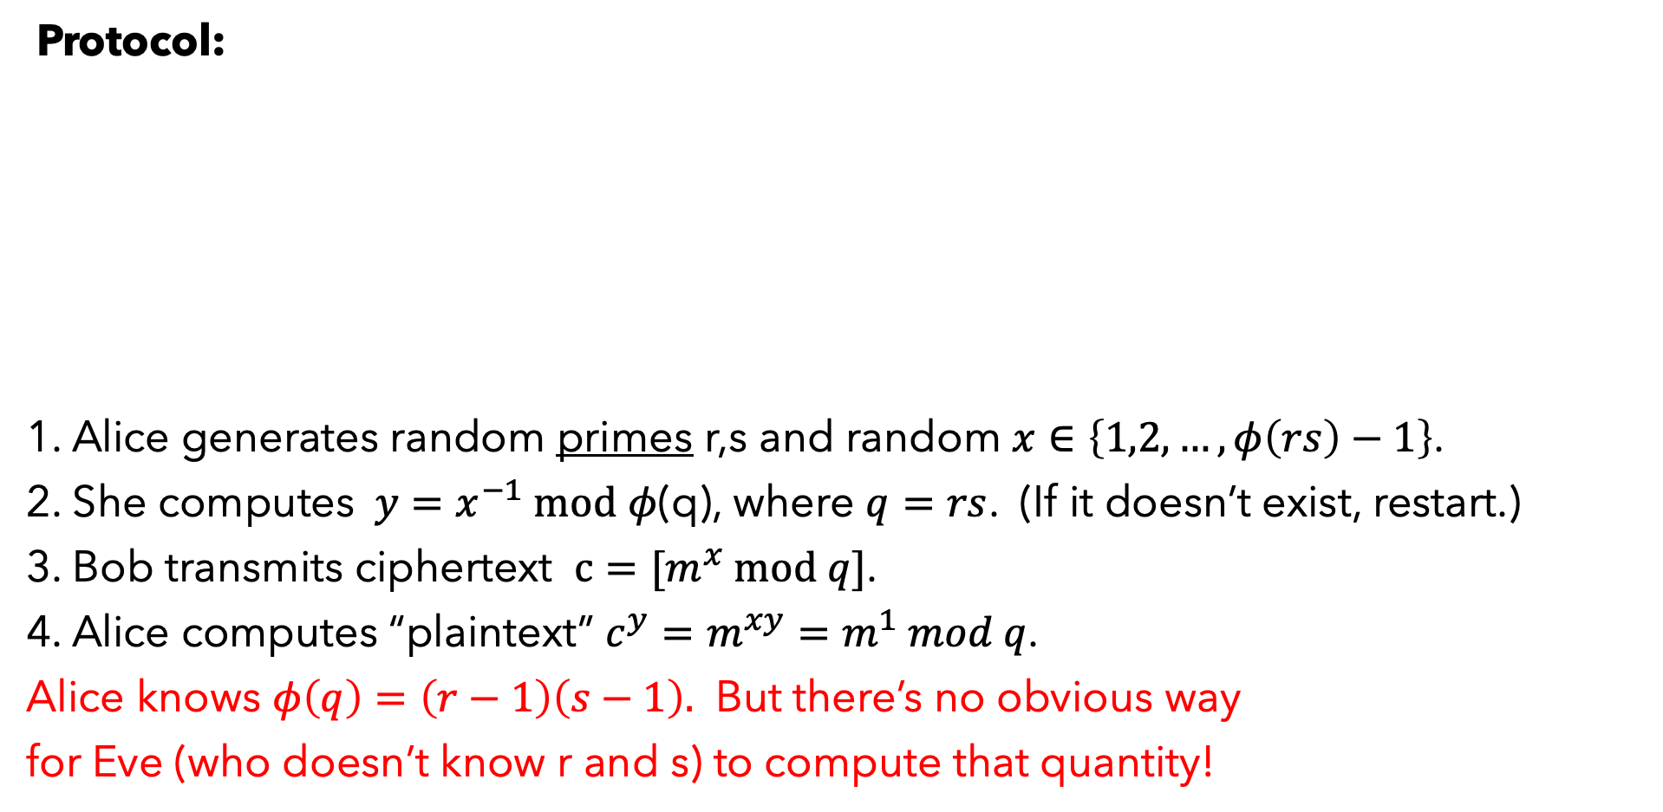


A SECOND ATTEMPT
Protocol:
1. Alice generates random primes r,s and random $x∈\left\{1,2,…,φ\left(rs\right)−1\right\}$.
2. She computes $y=x^{−1} mod$ $φ$(q), where $q=rs$. (If it doesn’t exist, restart.)
3. Bob transmits ciphertext $c=[m^{x} mod q]$.
4. Alice computes “plaintext” $c^{y}=m^{xy}=m^{1} mod q$.
Alice knows $φ\left(q\right)=\left(r−1\right)\left(s−1\right).$ But there’s no obvious way
for Eve (who doesn’t know r and s) to compute that quantity!
Eve
$$q,x$$
$$[m^{x} mod q]$$
$$q≔rs$$
$$message=m$$
This (roughly speaking) is RSA encryption.

Slide 24
SUMMING UP
We developed modular arithmetic some more (including an efficient algorithm for exponentiation).
We stated Fermat’s Little Theorem and discussed its implications for the inversion of the exponential function.
We developed a toy version of RSA encryption, which is based on the hardness of inverting the exponential function.
Next: We’ll give a more formal treatment of public-key encryption and RSA.

