Slide 1
MATH/CMSC 456 :: UPDATED COURSE INFO
Instructor: Gorjan Alagic (galagic@umd.edu); ATL 3102, office hours: by appointment
Textbook: Introduction to Modern Cryptography, Katz and Lindell;
Webpage: alagic.org/cmsc-456-cryptography-spring-2020/ (check for updates);
Piazza: piazza.com/umd/spring2020/cmsc456
ELMS: active, slides posted there, assignments will be as well.
Gradescope: active, access through ELMS.
Check these setups asap, and let me know if you run into issues!
TAs (Our spot: shared open area across from IRB 5234)
Elijah Grubb (egrubb@cs.umd.edu) 11am-12pm TuTh (Iribe);
Justin Hontz (jhontz@terpmail.umd.edu) 1pm-2pm MW (Iribe);
Additional help:
Chen Bai (cbai1@terpmail.umd.edu) 3:30-5:30pm Tu (2115 ATL, starting Feb 4)
Bibhusa Rawal (bibhusa@terpmail.umd.edu) 3:30-5:30pm Th (2115 ATL, starting Feb 6)

Slide 2
RECAP : LOGISTICS
Course plan (big picture)
8 lectures: symmetric-key crypto
4 lectures: RSA and Diffie-Hellman (Carl Miller); 2 lectures : secret sharing (Bill Gasarch);
midterm;
10 lectures: public-key crypto II, advanced topics;
final.
Grading: 40% homework, 30% midterm exam, 30% final exam
Homework(~ 10 sets): collaboration allowed, must write up your own, no late homework whatsoever (but lowest grade will be dropped); first set distributed 2nd week (ELMS → Gradescope.)
Exams:
closed book/device, one two-sided page of notes;
midterm March 31st ;
final May 18th .

Slide 3
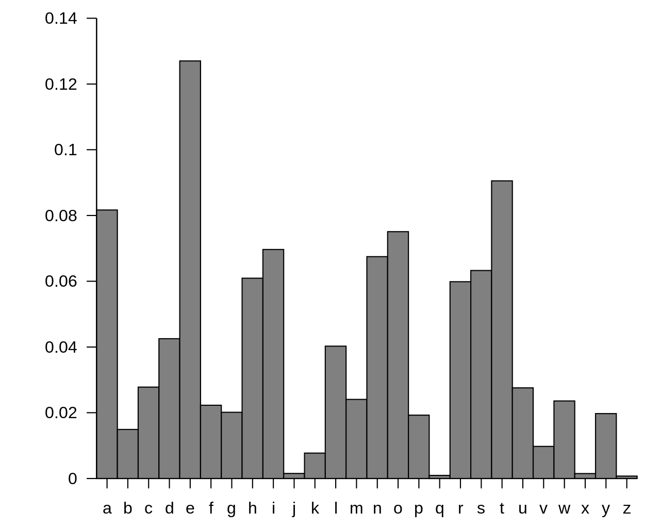
RECAP : HISTORICAL CIPHERS
encrypt
message (plaintext)
Caesar cipher
basic shift cipher;
broken: brute-force keysearch.
Substitution cipher
permute alphabet instead of shifting;
broken: frequency analysis.
Vigenére cipher
“add” plaintext and repeated passphrase;
broken: frequency analysis + brute-force key.
ABCDEFGHIJKLM $⋯$
ATTACK AT DAWN
decrypt
encrypt
decrypt
DWWDFNDWGDZR
key
$$A↦X$$
$$B↦F$$
$$C↦D$$
$$D↦L$$
$$E↦P$$
$$…$$
$$…$$
ciphertext
UXXWPF
AGSYRL
JXKYAH
BARGIZ
EBVCSW
KOWBTJ
EEHL
YOUCANEXPECTNOHELPFROMTHISSIDEOFTHERIVER
+
VICTORVICTORVICTORVICTORVICTORVICTORVICT
=
UXXWPFAGSYRLJXKYAHBARGIZEBVCSWKOWBTJEEHL

Slide 4
RECAP : MODERN CRYPTO
Why we do crypto this way?
history was not kind to previous ciphers;
from the 70s on: a much more rigorous approach;
be as careful and formal as possible when describing the task, the setting, what it means to be “secure,” the cryptosystem itself;
when possible, try to establish security via rigorous reasoning (i.e., theorem-proving.)
The course is about: the above approach, in the theoretical setting:
“possible in principle … vs impossible, even in principle”
Some things we won’t study:
IT security
real-world implementation details
specific performance/security tradeoffs
These are interesting things too, just not in scope.

Slide 5
RECAP: ENCRYPTION SCHEMES
Generic approach to encryption:
generate key via some algorithm: $k←KeyGen$
encrypt via some algorithm: $c←Enc_{k}\left(m\right)$
decrypt via some algorithm: $m←Dec_{k}\left(c\right)$
The triple $\left(KeyGen, Enc, Dec\right)$ is called an encryption scheme.
$$k←KeyGen$$
Correctness:
$Dec_{k}\left(Enc_{k}\left(m\right)\right)= m$ for all $m$.
Eve
Alice
Bob
$$k$$
$$k$$
Pick message $m$.
$$c←Enc_{k}\left(m\right)$$
$$c$$
$$m←Dec_{k}\left(c\right)$$

Slide 6
RECAP: ENCRYPTION SCHEMES: ONE-TIME PAD
Get very friendly and familiar with OTP: it will keep cropping up!
Examples: one-time pad (Vernam cipher, ~1882)
Key generation : sample uniformly random $k∈{\left\{0,1\right\}}^{n}$
Encryption : $Enc_{k}\left(m\right)=m⊕k$
Decryption : $Dec_{k}\left(c\right)=c⊕k$ ;
(note 1: messages are interpreted as bitstrings.)
(note 2: key length = message length = ciphertext length = $n$.)
We proved that this is secure under one (and hence all) of our notions of perfect secrecy.
Basic proof idea:
key is uniformly random;
ciphertext is a “shift” of the key by some string (namely the plaintext);
hence ciphertext is also uniformly random, for any plaintext;
this fulfills one of the definitions of perfect secrecy.
Bitwise XOR ($+ mod 2)$:
$$0⊕0=0$$
$$0⊕1=1$$
$$1⊕1=0$$
Food for thought.
OTP key space is of size $2^{n}$. If $n$ is small (e.g., $2^{8}=256)$, is brute-force key search possible?

Slide 7
RECAP: ENCRYPTION SCHEMES: SECRECY
Definition 1. (very informal) An encryption scheme is semantically secret if, for all choices of adversary $A,$ message $m,$ “prior information” function $g, and$ “target information” function $f,$the following property holds:
$$\operatorname{Pr}\left[f\left(m\right)←A\left(g\left(m\right), Enc_{k}\left(m\right)\right)\right]=\operatorname{Pr}\left[f\left(m\right)←A\left(g\left(m\right)\right)\right].$$
Definition 2. An encryption scheme is perfectly secret if, for every plaintext distribution $ℳ$, every plaintext $m$, and every ciphertext $c$,
$$\operatorname{Pr}\left[M=m \right|C=c]=\operatorname{Pr}\left[M=m\right].$$
Definition 3. An encryption scheme is perfectly secret if, for every plaintext distribution $ℳ$, every plaintext pair $m, m′$, and every ciphertext $c$,
$$\underset{k}{Pr}\left[Enc_{k}\left(m\right)=c\right]=\underset{k}{Pr}{[Enc_{k}\left(m^{′}\right)=c]}$$
Definition 4. An encryption scheme has perfectly indistinguishable ciphertexts if, for every adversary $A,$
$$\underset{k}{Pr}\left[A wins the IND game\right]=\frac{1}{2} .$$
Theorem 1. Definitions 1-4 are all equivalent.

Slide 8
II. (SIMPLE) ENCRYPTION (continued)
Reading: Ch.2 (p.25-40)

Slide 9
ONE-TIME PAD : THE SCHEME
One-time pad
Key generation : sample uniformly random $k∈{\left\{0,1\right\}}^{n}$;
Encryption : $Enc_{k}\left(m\right)=m⊕k$;
Decryption : $Dec_{k}\left(c\right)=c⊕k$ .
The OTP achieves perfect secrecy. Are there other schemes that do the job?
what this means: basically only one way to build an encryption scheme that satisfies perfect secrecy;
… and the one-time pad is it.
Shannon’s Theorem. Let $\left(KeyGen, Enc, Dec\right)$ be an encryption scheme that satisfies perfect secrecy. Let $ℳ, 𝒦, 𝒞$ denote the message, key, and ciphertext sets, respectively. Then $\left|𝒦\right|≥\left|ℳ\right|$. Moreover, if $\left|𝒦\right|=|ℳ|$, then
$KeyGen$ outputs a uniformly random key in $𝒦$, and
For every $m∈ℳ$ and every $c∈𝒞$, there exists a unique key $k∈𝒦$ such that $Enc_{k}\left(m\right)=c$.

Slide 10
ONE-TIME PAD : IS IT REALLY “PERFECT”?
What if they can’t?
Recall: we had a bunch of assumptions.
Alice and Bob can share a secret in advance;
they have their own private spaces;
Alice can send only one transmission, on a single channel;
Eve (eavesdropper) can observe everything that is transmitted on that channel.
Eve cannot do anything else.
What if Eve can look at Alice’s screen?
What if they want to send multiple messages?
What if Eve can also change messages in transit?
What if Eve knows something about what Alice will send?
Eve
Alice
Bob

Slide 11
ONE-TIME PAD : IS IT REALLY “PERFECT”?
Consider: using OTP twice, i.e., to send $2n$ bits.
Shannon’s theorem: for perfect secrecy, $\left|𝒦\right|=|ℳ|$. But here $\left|𝒦\right|=\left|ℳ\right|/2$. So not perfectly secret.
Some attack examples:
(1.) If Eve can’t know any of the plaintexts:
she observes two ciphertexts $c, c^{′}∈{\left\{0,1\right\}}^{n}$;
they were generated with same key: $c=m⊕k$ and $c^{′}=m^{′}⊕k$;
bitwise, so $c_{j}=c_{j}′$ if and only if $m_{j}=m_{j}′$. Plaintext information is leaking!
(2.) If Eve can know one of the plaintexts:
she is told $m$, and observes two ciphertexts $c, c^{′}∈{\left\{0,1\right\}}^{n}$;
now $c=m⊕k$, so Eve computes $k=c⊕m$;
complete key recovery, and trivial to recover $m′$.
In fact, Shannon says you can’t even use OTP to send $n+1$ bits securely!
SCHEME BROKEN
SCHEME BROKEN
Corollary. To encrypt a hard drive, you need another hard drive of equal size to store the decryption key.

Slide 12
ONE-TIME PAD : IS IT REALLY “PERFECT”?
What if they can’t?
Recall: we had a bunch of assumptions.
Alice and Bob can share a secret in advance;
they have their own private spaces;
Alice can send only one transmission, on a single channel;
Eve (eavesdropper) can observe everything that is transmitted on that channel.
Eve cannot do anything else.
Later: we will see that the other relaxations are also a disaster for the OTP.
So what does this mean?
By Shannon’s theorem, it means we have to give up on something in perfect secrecy.
What if Eve can look at Alice’s screen?
What if they want to send multiple messages?
What if Eve can also change messages in transit?
What if Eve knows something about what Alice will send?

Slide 13
III. COMPUTATIONALLY-SECURE ENCRYPTION
Reading: p.43-70

Slide 14
WHAT DO WE RELAX?
Shannon: if you want fancy features (like long messages) you have to give up something.
What can we give up?
If the adversary can break our scheme, but it takes them $10$ billion years, do we care?
If the adversary can break our scheme, but only with probability $1$ in ${10}^{100}$, do we care?
Probably not. Can we leverage that somehow? And get more out of crypto?
This “simple” change allows us to go from boring, almost useless crypto (OTP) …
… to amazing crypto whose limits we are still trying to understand!
Definition 4. An encryption scheme has perfectly indistinguishable ciphertexts if, for every adversary $A,$
$$\underset{k}{Pr}\left[A wins the IND game\right]=\frac{1}{2} .$$
YES!

Slide 15
COMPUTATIONAL CRYPTO: A PREVIEW
Remember from programming:
Random number generators: deterministic programs that turn a small seed into a much longer sequence of “random-looking” numbers.
Suppose
$$G:{\left\{0,1\right\}}^{n}→{\left\{0,1\right\}}^{2n}$$
is such a generator.
Let’s postpone technical details for now.
What could this give us? Recall OTP:
Key generation : sample uniformly random $k∈{\left\{0,1\right\}}^{n}$;
Encryption : $Enc_{k}\left(m\right)=m⊕k$;
Decryption : $Dec_{k}\left(c\right)=c⊕k$ .
In pictures:
Reasonable to hope: if no “feasible” algorithm can distinguish $G(k)$ from random, then this scheme is secure against all “feasible” adversaries.
n bits of perfect
randomness
$$k$$
$$k$$
2n bits of “good enough”
randomness?
$$G$$
$${\left\{0,1\right\}}^{n}$$
$$⨁$$
$${\left\{0,1\right\}}^{n}$$
$${\left\{0,1\right\}}^{2n}$$
$$⨁$$
$${\left\{0,1\right\}}^{2n}$$
plaintext
ciphertext
plaintext
ciphertext

Slide 16
COMPUTATIONAL CRYPTO: A PREVIEW
Remember from programming:
Random number generators: deterministic programs that turn a small seed into a much longer sequence of “random-looking” numbers.
Suppose
$$G:{\left\{0,1\right\}}^{n}→{\left\{0,1\right\}}^{2n}$$
is such a generator.
Let’s postpone technical details for now.
What could this give us? Recall OTP:
Key generation : sample uniformly random $k∈{\left\{0,1\right\}}^{n}$;
Encryption : $Enc_{k}\left(m\right)=m⊕k$;
Decryption : $Dec_{k}\left(c\right)=c⊕k$ .
In pictures:
Reasonable to hope: if no “feasible” algorithm can distinguish $G(k)$ from random, then this scheme is secure against all “feasible” adversaries.
n bits of perfect
randomness
$$k$$
$$k$$
2n bits of “good enough”
randomness?
$$G$$
$${\left\{0,1\right\}}^{n}$$
$$⨁$$
$${\left\{0,1\right\}}^{n}$$
$${\left\{0,1\right\}}^{n}$$
$$⨁$$
$${\left\{0,1\right\}}^{n}$$
plaintext
ciphertext
$${\left\{0,1\right\}}^{n}$$
$$⨁$$
$${\left\{0,1\right\}}^{n}$$

Slide 17
COMPUTATIONAL CRYPTO: CHALLENGES
Remember from programming:
Random number generators: deterministic programs that turn a small seed into a much longer sequence of “random-looking” numbers.
Suppose
$$G:{\left\{0,1\right\}}^{n}→{\left\{0,1\right\}}^{2n}$$
is such a generator.
Let’s postpone technical details for now.
What could this give us? Recall OTP:
Key generation : sample uniformly random $k∈{\left\{0,1\right\}}^{n}$;
Encryption : $Enc_{k}\left(m\right)=m⊕k$;
Decryption : $Dec_{k}\left(c\right)=c⊕k$ .
In pictures:
Reasonable to hope: if no “feasible” algorithm can distinguish $G(k)$ from random, then this scheme is secure against all “feasible” adversaries.
n bits of perfect
randomness
$$k$$
$$k$$
2n bits of “good enough”
randomness?
$$G$$
$${\left\{0,1\right\}}^{n}$$
$$⨁$$
$${\left\{0,1\right\}}^{n}$$
$${\left\{0,1\right\}}^{n}$$
$$⨁$$
$${\left\{0,1\right\}}^{n}$$
plaintext
ciphertext
$${\left\{0,1\right\}}^{n}$$
$$⨁$$
$${\left\{0,1\right\}}^{n}$$
Could we prove this?

Slide 18
COMPUTATIONAL CRYPTO: CHALLENGES
This intuition seems sound. How can we formalize it?
1. Notions to define:
“random-looking”
“good-enough” randomness
“feasible” vs “infeasible” algorithms
“secure” encryption (can’t be same as perfect secrecy, we gave up on that.)
2. Stuff to construct:
a function which produces “good enough” randomness against “feasible” algorithms
3. Theorems we have to prove:
the construction in the previous slide is secure.

Slide 19
EFFICIENT vs INEFFICIENT ALGORITHMS
What should “feasible” (or efficient) mean?
lots of natural choices, but…
we are interested in “possible in principle” vs “not possible, even in principle;”
we want the theory to be simple and easy to work with;
in particular, we don’t want to worry about details of the computational model.
To address all of these issues, we will take an approach similar to that of complexity theory.

Slide 20
EFFICIENT vs INEFFICIENT ALGORITHMS
What should “feasible” (or efficient) mean?
running time measured as a function of input size (e.g., searching a list of size $n$ takes time $n$; generating a list of all possible pairs takes time $n^{2}$.)
work asymptotically: we care about the large-$n$ limit, not what happens for, e.g., $n=20$;
randomness: all algorithms are assumed to have access to as many uniformly random coins as needed;
efficient will mean that the running time is polynomial in the size of the input.
A bit more carefully:
We will often use the shorthand PPT meaning Probabilistic, Polynomial-Time algorithm.
Definition. An algorithm $A$ is efficient if there exists a polynomial $p:ℕ→ℕ$ and a positive integer $N$ such that for all $n>N$ and all $x∈{\left\{0,1\right\}}^{n},$ the running time of $A$ on input $x$ is at most $p\left(n\right)$.

Slide 21
EFFICIENT vs INEFFICIENT ALGORITHMS
What about “infeasible”?
just the negation of “feasible”!
concretely: the running time is larger than every polynomial
i.e., bigger than $n^{100}$ or even $n^{{10}^{100}}$;
for example, exponential (e.g., $2^{n}$) or more;
but not necessarily exponential: consider $2^{√n}$ or $n^{\log\left(n\right)}$;
we use the term superpolynomial.
What about success probability?
Similar approach: asymptotic, polynomial versus superpolynomial.
efficient : success probability $1/p\left(n\right)$ for some polynomial $p$.
inefficient : success probability smaller than $1/p(n)$ for all polynomials $p$.
also called negligible
and written $negl(n)$.

Slide 22
EFFICIENT vs INEFFICIENT ALGORITHMS
Recall: algorithms can often be repeated to amplify success probability;
Our notions are “stable” under this sort of amplification;
In particular:
consider some random experiment (e.g., an adversary attacks some cryptosystem.)
suppose some event $E$(e.g., system is broken) occurs with negligible probability;
now repeat the experiment $p(n)$ times for any polynomial $p$;
what is the probability that $E$ occurs in at least one of the experiments?
Exercise: it’s still negligible.

Slide 23
COMPUTATIONAL CRYPTO: CHALLENGES
This intuition seems sound. How can we formalize it?
1. Notions to define:
“random-looking”
“good-enough” randomness
“feasible” vs “infeasible” algorithms
“secure” encryption (can’t be same as perfect secrecy, we gave up on that.)
2. Stuff to construct:
a function which produces “good enough” randomness against “feasible” algorithms
3. Theorems we have to prove:
the construction in the previous slide is secure.

Slide 24
PSEUDORANDOMNESS
Cryptographic pseudorandomness
We’re not happy with garden-variety random number generators.
We need something much stronger. We need indistinguishability from perfectly random.
Let $G:{\left\{0,1\right\}}^{n}→{\left\{0,1\right\}}^{2n}$. Pick some algorithm $D$. Consider these two experiments:
Crucial: 𝒔 is sampled uniformly at random! (Otherwise, $G(s)$could simply be a fixed string!)
Want: there is no efficient algorithm for $D that c$an distinguish these two experiments.
$$r←{\left\{0,1\right\}}^{2n}$$
$$s←{\left\{0,1\right\}}^{n}$$
$$r$$
$$D$$
$$b$$
$$s$$
$$G$$
$$D$$
$$b$$

Slide 25
PSEUDORANDOM GENERATORS
Cryptographic pseudorandomness
Definition. A pseudorandom generator is a deterministic, polynomial-time algorithm $G$ satisfying the following:
(expansion) $G:{\left\{0,1\right\}}^{n}→{\left\{0,1\right\}}^{ℓ\left(n\right)}$ for some fixed polynomial $ℓ$ satisfying $ℓ\left(n\right)>n$ for all $n$.
(pseudorandomness) for every PPT algorithm $D$,
$$\left|\operatorname{Pr}\left[D\left(G\left(s\right)\right)=1\right] −\operatorname{Pr}{ \left[D\left(r\right)=1\right]}\right|≤negl\left(n\right).$$
$$s←{\left\{0,1\right\}}^{n}$$
$$r←{\left\{0,1\right\}}^{ℓ(n)}$$
$$s←{\left\{0,1\right\}}^{n}$$
$$r←{\left\{0,1\right\}}^{ℓ(n)}$$
$$s$$
$$G$$
$$D$$
$$b$$
$$r$$
$$D$$
$$b$$

Slide 26
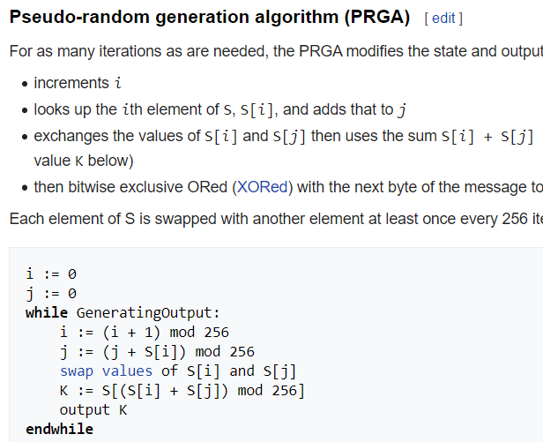
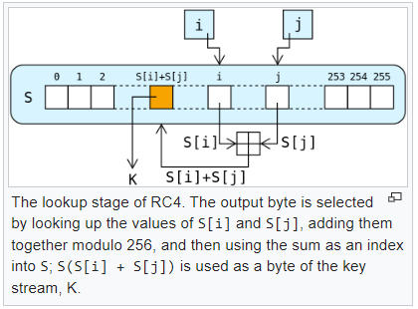
PSEUDORANDOM GENERATORS (PRGs)
How to break any PRG (in two easy steps).
Step 1: look up the PRG spec online;
Step 2: run the algorithm $D$ below.
input: $r∈{\left\{0,1\right\}}^{ℓ\left(n\right)}$
try every possible $s∈{\left\{0,1\right\}}^{n};$
if you find one such that $G\left(s\right)=r$, return $1$.
if not, return $0$.
$D$ always outputs $1.$
$$s←{\left\{0,1\right\}}^{n}$$
$$r←{\left\{0,1\right\}}^{ℓ(n)}$$
$D$ outputs $0$ except
with probability
$2^{n−ℓ\left(n\right)}$.
$$s$$
$$G$$
$$D$$
$$b$$
$$r$$
$$D$$
$$b$$

Slide 27
PSEUDORANDOM GENERATORS (PRGs)
$${\left\{0,1\right\}}^{ℓ\left(n\right)}$$
How to break any PRG (in two easy steps).
Step 1: look up the PRG spec online;
Step 2: run the algorithm $D$ below.
input: $r∈{\left\{0,1\right\}}^{ℓ\left(n\right)}$
try every possible $s∈{\left\{0,1\right\}}^{n};$
if you find one such that $G\left(s\right)=r$, return $1$.
if not, return $0$.
$$r$$
$${\left\{0,1\right\}}^{n}$$
$$G$$
$$\operatorname{Pr}\left[r∈G\left({\left\{0,1\right\}}^{n}\right)\right]≤\frac{{\left\{0,1\right\}}^{n}}{{\left\{0,1\right\}}^{ℓ\left(n\right)} }=2^{n−ℓ\left(n\right)}≤1/2$$
$$⇒\left|\operatorname{Pr}\left[D\left(G\left(s\right)\right)=1\right] −\operatorname{Pr}\left[D\left(r\right)=1\right]\right|≥1/2.$$
$D$ always outputs $1.$
$$s←{\left\{0,1\right\}}^{n}$$
$$r←{\left\{0,1\right\}}^{ℓ(n)}$$
$D$ outputs $0$ except
with probability
$2^{n−ℓ\left(n\right)}$.
$$s$$
$$G$$
$$D$$
$$b$$
$$r$$
$$D$$
$$b$$

Slide 28
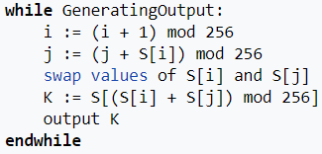
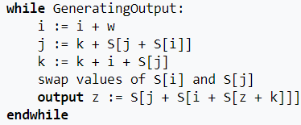
PSEUDORANDOM GENERATORS (PRGs)
How about this? Is this a PRG?
(input is 256 bytes; output length arbitrary.)
How to construct PRGs.
It’s an art form. Lots of constructions do exist.
For example: is this a PRG?
input: $s∈{\left\{0,1\right\}}^{n}$
compute $b=s_{1}⊕s_{2}⊕⋯⊕s_{n}$
output $s||b∈{\left\{0,1\right\}}^{n+1}$.
If yes, why? If no, how would you break it?
Or this one?
(arithmetic still mod 256)

Slide 29
COMPUTATIONAL CRYPTO: CHALLENGES
This intuition seems sound. How can we formalize it?
1. Notions to define:
“random-looking”
“good-enough” randomness
“feasible” vs “infeasible” algorithms
“secure” encryption (can’t be same as perfect secrecy, we gave up on that.)
2. Stuff to construct:
a function which produces “good enough” randomness against “feasible” algorithms
3. Theorems we have to prove:
the construction in the previous slide is secure.

Slide 30
RECALL: PERFECT SECRECY
Definition 1. (very informal) An encryption scheme is semantically secret if, for all choices of adversary $A,$ message $m,$ “prior information” function $g, and$ “target information” function $f,$the following property holds:
$$\operatorname{Pr}\left[f\left(m\right)←A\left(g\left(m\right), Enc_{k}\left(m\right)\right)\right]=\operatorname{Pr}\left[f\left(m\right)←A\left(g\left(m\right)\right)\right].$$
Definition 2. An encryption scheme is perfectly secret if, for every plaintext distribution $ℳ$, every plaintext $m$, and every ciphertext $c$,
$$\operatorname{Pr}\left[M=m \right|C=c]=\operatorname{Pr}\left[M=m\right].$$
Definition 3. An encryption scheme is perfectly secret if, for every plaintext distribution $ℳ$, every plaintext pair $m, m′$, and every ciphertext $c$,
$$\underset{k}{Pr}\left[Enc_{k}\left(m\right)=c\right]=\underset{k}{Pr}{[Enc_{k}\left(m^{′}\right)=c]}$$
Definition 4. An encryption scheme has perfectly indistinguishable ciphertexts if, for every adversary $A,$
$$\underset{k}{Pr}\left[A wins the IND game\right]=\frac{1}{2} .$$
Theorem 1. Definitions 1-4 are all equivalent.

Slide 31
INDISTINGUISHABILITY OF CIPHERTEXTS
Indistinguishability experiment (IND).
$A$ outputs two messages $m_{0},m_{1}$ with $\left|m_{0}\right|=\left|m_{1}\right|$;
We sample a key $k←KeyGen,$ and a coin $b←\left\{0,1\right\};$
then we give $A$ the ciphertext $c←Enc_{k}\left(m_{b}\right);$
$A$outputs a bit $b′$.
We say $A$wins if $b=b′$.
$$A$$
$$m_{0}$$
$$c$$
$$A$$
$$Enc_{k}$$
$$b′$$
$$m_{1}$$
$$A$$
$$m_{0}$$
$$A$$
$$c$$
$$b′$$
$$m_{1}$$
$$Enc_{k}$$
Definition. An encryption scheme $\left(KeyGen, Enc, Dec\right)$ has indistinguishable ciphertexts if, for every PPT adversary $A,$
$$\operatorname{Pr}\left[A wins IND\right]≤\frac{1}{2}+negl\left(n\right).$$

Slide 32
COMPUTATIONALLY-SECURE ENCRYPTION
Construction.
Let $G:{\left\{0,1\right\}}^{n}→{\left\{0,1\right\}}^{ℓ\left(n\right)}$ be a pseudorandom generator.
Define an encryption scheme (for $ℓ(n)$-bit messages) as follows:
clearly, $ℓ\left(n\right)$can be much larger than $n;$
so we can’t hope for perfect secrecy (Shannon’s theorem);
can we have IND (indistinguishability of ciphertexts)?
Construction: PRG scheme.
$$k$$
Key generation : sample $k←{\left\{0,1\right\}}^{n}$;
Encryption : $Enc_{k}\left(m\right)=m⊕G(k)$;
Decryption : $Dec_{k}\left(c\right)=c⊕G(k)$ .
$$G$$
$${\left\{0,1\right\}}^{ℓ(n)}$$
$$⨁$$
$${\left\{0,1\right\}}^{ℓ(n)}$$
plaintext
ciphertext

Slide 33
COMPUTATIONAL CRYPTO: CHALLENGES
This intuition seems sound. How can we formalize it?
1. Notions to define:
“random-looking”
“good-enough” randomness
“feasible” vs “infeasible” algorithms
“secure” encryption (can’t be same as perfect secrecy, we gave up on that.)
2. Stuff to construct:
a function which produces “good enough” randomness against “feasible” algorithms
3. Theorems we have to prove:
the construction in the previous slide is secure.

Slide 34
PRG ENCRYPTION: SECURITY PROOF
$$A$$
$$m_{0}$$
$$c$$
$$A$$
$$Enc_{k}$$
$$b′$$
$$m_{1}$$
Claim: PRG encryption has indistinguishable ciphertexts.
How to prove this?
What’s our only leverage? The assumption that $G$ is a PRG;
So let’s try proof by contradiction:
“If there’s an attacker $A$ that can win the IND game,
then there’s an attacker $D$ against $G$.”
called a “reductionist proof” or “proof by reduction.”
used a lot in crypto: learn it, get used to it!
$$A$$
$$m_{0}$$
$$A$$
$$c$$
$$b′$$
$$m_{1}$$
$$Enc_{k}$$
distinguisher

Slide 35
PRG ENCRYPTION: SECURITY PROOF: RECALL PRG
Cryptographic pseudorandomness
Definition. A pseudorandom generator is a deterministic, polynomial-time algorithm $G$ satisfying the following:
(expansion) $G:{\left\{0,1\right\}}^{n}→{\left\{0,1\right\}}^{ℓ\left(n\right)}$ for some fixed polynomial $ℓ$ satisfying $ℓ\left(n\right)>n$ for all $n$.
(pseudorandomness) for every PPT algorithm $D$,
$$\left|\operatorname{Pr}\left[D\left(G\left(s\right)\right)=1\right] −\operatorname{Pr}{ \left[D\left(r\right)=1\right]}\right|≤negl\left(n\right).$$
$$s←{\left\{0,1\right\}}^{n}$$
$$r←{\left\{0,1\right\}}^{ℓ(n)}$$
$$s←{\left\{0,1\right\}}^{n}$$
$$r←{\left\{0,1\right\}}^{ℓ(n)}$$
$$s$$
$$G$$
$$D$$
$$b$$
$$r$$
$$D$$
$$b$$

Slide 36
PRG ENCRYPTION: SECURITY PROOF: RECALL IND
Indistinguishability experiment (IND).
$A$ outputs two messages $m_{0},m_{1}$ with $\left|m_{0}\right|=\left|m_{1}\right|$;
We sample a key $k←KeyGen,$ and a coin $b←\left\{0,1\right\};$
then we give $A$ the ciphertext $c←Enc_{k}\left(m_{b}\right);$
$A$outputs a bit $b′$.
We say $A$wins if $b=b′$.
$$A$$
$$m_{0}$$
$$c$$
$$A$$
$$Enc_{k}$$
$$b′$$
$$m_{1}$$
$$A$$
$$m_{0}$$
$$A$$
$$c$$
$$b′$$
$$m_{1}$$
$$Enc_{k}$$
Definition. An encryption scheme $\left(KeyGen, Enc, Dec\right)$ has indistinguishable ciphertexts if, for every PPT adversary $A,$
$$\operatorname{Pr}\left[A wins IND\right]≤\frac{1}{2}+negl\left(n\right).$$

Slide 37
PRG ENCRYPTION: SECURITY PROOF
“If there’s an attacker $A$ that can win the IND game, then there’s a distinguisher $D$ against $G$.”
Key facts:
if $r$ is uniformly random, $A$ is playing the IND game against the one-time pad.
if $r$ is $G(s)$, $A$ is playing the IND game against the PRG scheme.
$$D$$
$$r$$
$$m_{0}, m_{1}$$
$$A$$
$$∈{\left\{0,1\right\}}^{ℓ\left(n\right)}$$
$$\text{Generate} b←\left\{0,1\right\}$$
Compute $c=m_{b}⊕r$
$$c$$
$$b′$$
If $b=b′$, output 1;
Otherwise output 0.
$z∈\{0,1\}$.
$A$ will LOSE: OTP perfect!
$A$ will WIN: by assumption!

Slide 38
PRG ENCRYPTION: SECURITY PROOF
Let’s analyze $D.$
Two cases:
(1.) $r$ is uniformly random in ${\left\{0,1\right\}}^{ℓ\left(n\right)}$.
Then $D$ is an exact simulation of this IND game:
$A$plays against the one-time pad with keylength $ℓ\left(n\right);$
by perfect secrecy of OTP, $A$loses:$\operatorname{Pr}\left[b=b^{′}\right]=1/2$;
it follows that $\operatorname{Pr}\left[z=1\right]=1/2$.
(2.) $r=G\left(s\right)$ for uniformly random $s∈{\left\{0,1\right\}}^{n}$.
Then $D$ is an exact simulation of this IND game:
$A$plays against the PRG scheme with PRG $G;$
by assumption, $A$ wins noticeably, i.e. $\operatorname{Pr}\left[b=b^{′}\right]≥1/2$ $+1/p(n)$ for some polynomial $p$;
it follows that $\operatorname{Pr}\left[z=1\right]=1/2$ $+1/p(n)$.
$$\left|\operatorname{Pr}\left[D\left(G\left(s\right)\right)=1\right]−\operatorname{Pr}\left[D\left(r\right)=1\right]\right|= \left|\left(\frac{1}{2}+\frac{1}{p\left(n\right)}\right) −\frac{1}{2} \right|=\frac{1}{p\left(n\right)}.$$

