Slide 1
Cryptography CMSC/MATH 456 : Spring 2020

Slide 2
ABOUT THE COURSE
Instructor: Gorjan Alagic (galagic@umd.edu); ATL 3102, office hours: by appointment
Textbook: Introduction to Modern Cryptography, Katz and Lindell;
Webpage: alagic.org/cmsc-456-cryptography-spring-2020/ (check for updates);
Piazza, Gradescope, ELMS: coming soon.
TAs:
Elijah Grubb (egrubb@cs.umd.edu) 11am-12pm TuTh (Iribe);
Justin Hontz (jhontz@terpmail.umd.edu) 1pm-2pm MW (Iribe);
Our designated spot: shared open area across from IRB 5234
Additional help:
Chen Bai (cbai1@terpmail.umd.edu) 3:30-5:30pm Tu (2115 ATL, starting Feb 4)
Bibhusa Rawal (bibhusa@terpmail.umd.edu) 3:30-5:30pm Th (2115 ATL, starting Feb 6)

Slide 3
ABOUT THE COURSE
The fun stuff (see syllabus for details.)
Grading: 40% homework, 30% midterm exam, 30% final exam
Homework (~ 10 sets):
collaboration allowed, but must write up your own;
no late homework whatsoever (but lowest grade will be dropped);
first set distributed 2nd week.
Exams:
closed book/device, one two-sided page of notes;
midterm March 31st ;
final May 18th .

Slide 4
ABOUT THE COURSE
Approximate course plan:
Topic | Dates
Intro and symmetric-key cryptography (8 lectures) | January 28 – February 20
RSA and Diffie-Hellman (4 lectures) Carl Miller | February 25 – March 5
Secret sharing (2 lectures) Bill Gasarch | March 10 - 12
Midterm review and midterm; 2 fun guest lectures | March 24 – Apr 2
Public-key cryptography II, advanced topics (10 lectures) | Apr 7 – May 12

Slide 5
WHAT IS THIS COURSE ABOUT?
What it IS about:
theoretical cryptography;
“replacing trust with mathematics” (- Boaz Barak);
exploring limits of what is possible in principle;
fundamental tasks: encryption, authentication
What we WILL do:
define concepts rigorously, prove theorems
analyze cryptosystems and attacks in terms of “possible in principle” vs “impossible, even in principle”
What it is NOT about:
practical IT security;
hacking, spoofing, fishing, DOS attacks, etc.;
real-world implementations;
bleeding edge theory: obfuscation, quantum FHE
What we will NOT do:
implement real cryptosystems or attacks
analyze cryptosystems and attacks in terms of concrete costs (e.g., 20 minutes vs 2 hours on a four-core Xeon with 32GB RAM…?)

Slide 6
WHAT IS THIS COURSE ABOUT?
What background should you refresh?
Discrete probability: random variables and events, conditional probability, expectation, etc.;
Theory of computation: basic algorithms and programming concepts, asymptotic analysis (O-notation), etc;
Mathematical rigor: formal definitions, notation, theorems, proofs;
Basically, the stuff you (hopefully) did in discrete math.

Slide 7
I. THE (SKETCHY) HISTORY OF CRYPTO
Reading: xv – p.24.

Slide 8
WHAT IS CRYPTOGRAPHY?
What is cryptography?
How will we study it in this course?
Why will we do it that way?
To answer all this: need to first look at how crypto has been done for most of history.
This is not a “boring history lesson” you can ignore!
people were very clever before computers too!
develop intuition about what “good crypto” and “bad crypto” look like;
learn basic techniques for breaking cryptosystems;
understand why we now do crypto the way we do it;
some historical schemes still crop up in modern crypto!
…and besides, history is awesome!

Slide 9
HISTORICAL CIPHERS : CAESAR CIPHER
Caesar cipher
Goal: “send secret messages”
shift each letter in the message, remove spaces
Caesar himself used this; his key was 3, like this:
apparently, Caesar used this successfully for many years
in 2011, used in a plot to attack airliners (no, really.)
Is it secure?
encrypt
ABCDEFGHIJKLM $⋯$
decrypt
message (plaintext)
ATTACK AT DAWN
encrypt
decrypt
DWWDFNDWGDZR
ciphertext

Slide 10
HISTORICAL CIPHERS : CAESAR CIPHER
No! Brute force keysearch:
Suppose you see the message “dwwdfndwrqfh” (but you don’t know Caesar’s key.)
Try all possible decryption keys:
Only 26 possibilities, so easy! (The 2011 plot failed and the plotters were caught.)
Must have: big keyspace.
0 | dwwdfndwrqfh
-1 | cvvcemcvqpeg
-2 | buubdlbupodf
-3 | attackatonce
-4 | zsszbjzsnmbd
-5 | yrryaiyrmlac
…
…

Slide 11
HISTORICAL CIPHERS : SUBSTITUTION CIPHER
Substitution cipher
each letter of the alphabet is mapped to another, randomly selected letter
for example:
used in 1586 plot by Mary, Queen of Scots to assassinate Queen Elizabeth and install Mary as queen;
Mary used the cipher to instruct her collaborators to kill the queen!
Key space: $26!≈{10}^{26}$
Is it secure?
key
BEE BED DEAD
$$A↦X$$
$$B↦F$$
$$C↦D$$
$$D↦L$$
$$E↦P$$
$$…$$
$$…$$
encrypt
decrypt
FPPFPLLPXL

Slide 12
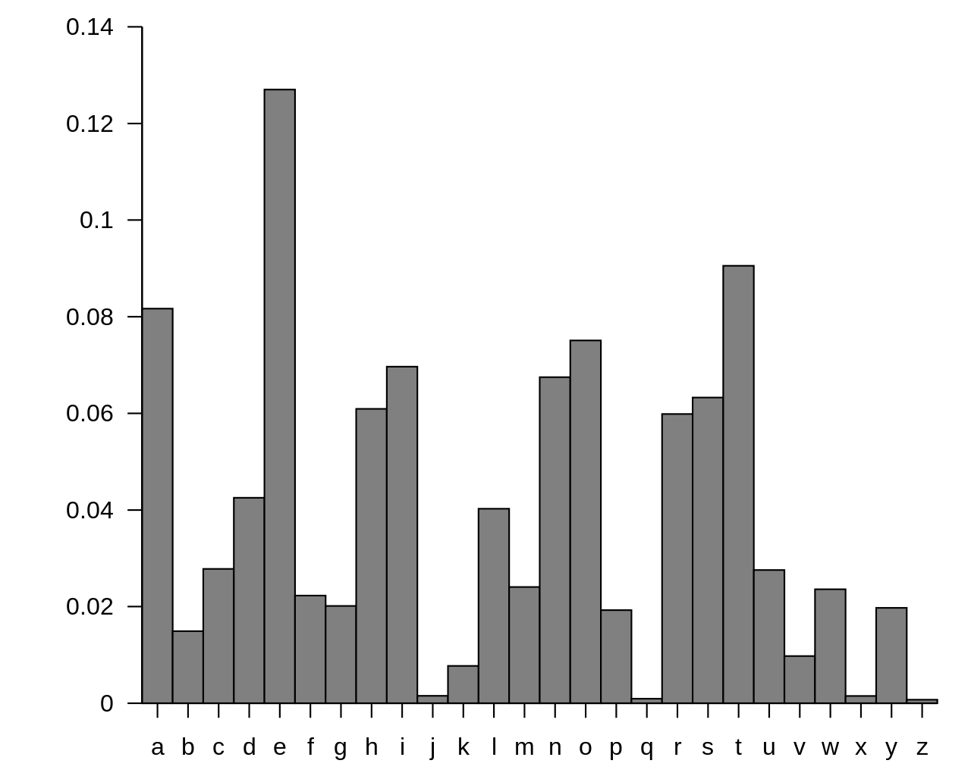
HISTORICAL CIPHERS : SUBSTITUTION CIPHER
Unfortunately for Mary, an Arab philosopher named Al-Kindi broke this cipher over 700 years prior.
Frequency analysis
plot average frequency of letters in spoken English;
do the same for the encrypted message;
permute the letters to make the plots match up;
the resulting permutation is (probably close to) the key!
Mary’s messages were intercepted and broken with frequency analysis;
using the key, the messages were even changed to get her to reveal her conspirators (authentication?);
based on this, Mary was found guilty and beheaded.
Crypto mattered a lot even in 1586!

Slide 13
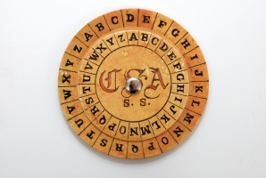
HISTORICAL CIPHERS : VIGENÈRE CIPHER
If Mary had a better cryptographer, she would have used Vigenère cipher (discovered a few years prior.)
Used by the Confederacy in the U.S. Civil War.
Is it secure?
YOUCANEXPECTNOHELPFROMTHISSIDEOFTHERIVER
+ means add letters
as numbers (mod 28)
+
VICTORVICTORVICTORVICTORVICTORVICTORVICT
=
UXXWPFAGSYRLJXKYAHBARGIZEBVCSWKOWBTJEEHL

Slide 14
HISTORICAL CIPHERS : VIGENÈRE CIPHER
YOUCANEXPECTNOHELPFROMTHISSIDEOFTHERIVER
Guess the length of the passphrase. Then split up ciphertext:
each column is a Caesar cipher; $26$ choices there, but ${26}^{6}≈309$ million total! No good…
instead, frequency analysis with a twist: plot of first column = English alphabet translated by V!
It took over 300 years for someone to figure this out and break Vigenère. (So Mary might have gotten away with it!)
+
VICTORVICTORVICTORVICTORVICTORVICTORVICT
=
UXXWPFAGSYRLJXKYAHBARGIZEBVCSWKOWBTJEEHL
UXXWPF
AGSYRL
JXKYAH
BARGIZ
EBVCSW
KOWBTJ
EEHL

Slide 15
WHAT WENT WRONG?
Lessons learned
key space needs to be large (prevent brute force key search);
scheme needs to resist frequency analysis, sometimes in non-obvious ways;
what else? Is that enough?
… as it turns out, it’s not; throughout history, each attempt to “patch” was eventually circumvented.
(fun read: Enigma in WW2.)
The first “unbreakable” cipher was not discovered until 1882!
why did it take so long?
people have been clever for a long time; that didn’t start in 1882;
modern crypto seems to be a lot more “stable” than the stuff we discussed above
what changed?
(also: if there’s an unbreakable cipher, what is left to do? As we will see, a lot!)

Slide 16
WHAT DO WE DO DIFFERENTLY NOW?
The modern (theoretical) approach (~1970s on)
emphasis on mathematical rigor
formal definitions : what is known to everyone, and what needs to stay secret?
formal definitions : what exactly is the cryptosystem trying to achieve?
formal definitions : when is a cryptosystem considered “secure”?
security proofs: mathematical theorems establishing security (with important caveats!)
… and lots and lots of clever cryptographic (design) work and cryptanalytic (attack) work!
These will be the ideas that we will explore in this course.
Kerckhoffs's principle
A cryptosystem should be secure even if everything about the system, except the key, is public knowledge.
“the algorithm”
“the key”

Slide 17
II. (SIMPLE) ENCRYPTION
Reading: Ch.2 (p.25-40)

Slide 18
ENCRYPTION : THE SETTING
Task: Alice wants to send a single message to Bob, but Eve is watching the channel.
Assumptions:
Alice and Bob can share a secret in advance;
they have their own private spaces;
Alice can send only one transmission, on a single channel;
Eve (eavesdropper) can observe everything that is transmitted on that channel.
Eve cannot do anything else.
Wait, why not just use this “assumption” to send the message?
Eve
Alice
Bob

Slide 19
ENCRYPTION SCHEMES
Message-independent distribution.
Generic approach to this task:
generate key via some algorithm: $k←KeyGen$
encrypt via some algorithm: $c←Enc_{k}\left(m\right)$
decrypt via some algorithm: $m←Dec_{k}\left(c\right)$
The triple $\left(KeyGen, Enc, Dec\right)$ is called an encryption scheme.
Eve
Alice
Bob

Slide 20
ENCRYPTION SCHEMES
Generic approach to this task:
generate key via some algorithm: $k←KeyGen$
encrypt via some algorithm: $c←Enc_{k}\left(m\right)$
decrypt via some algorithm: $m←Dec_{k}\left(c\right)$
The triple $\left(KeyGen, Enc, Dec\right)$ is called an encryption scheme.
$$k←KeyGen$$
Correctness:
$Dec_{k}\left(Enc_{k}\left(m\right)\right)= m$ for all $m$.
Eve
Alice
Bob
$$k$$
$$k$$
Pick message $m$.
$$c←Enc_{k}\left(m\right)$$
$$c$$
$$m←Dec_{k}\left(c\right)$$

Slide 21
ENCRYPTION SCHEMES
Examples
Let’s look at our initial Caesar’s cipher example.
$$3←KeyGen$$
Eve
Alice
Bob
$$3$$
$$3$$
Pick message ATTACK AT DAWN.
$$\text{DWWDFNDWGDZR}←Enc_{3}\left(\text{ATTACK} \text{AT} \text{DAWN}\right)$$
$$\text{DWWDFNDWGDZR}$$
$$\text{ATTACK} \text{AT} \text{DAWN}←Dec_{3}\left(\text{DWWDFNDWGDZR}\right)$$
Eve tries all 26 possible shifts,
recovers key and message.
SCHEME BROKEN

Slide 22
ENCRYPTION SCHEMES: ONE-TIME PAD
Bitwise XOR ($+ mod 2)$:
$$0⊕0=0$$
$$0⊕1=1$$
$$1⊕1=0$$
Examples: one-time pad (Vernam cipher, ~1882)
Key generation : sample uniformly random $k∈{\left\{0,1\right\}}^{n}$
Encryption : $Enc_{k}\left(m\right)=m⊕k$
Decryption : $Dec_{k}\left(c\right)=c⊕k$ ;
(note 1: messages are interpreted as bitstrings.)
(note 2: key length = message length = ciphertext length = $n$.)
Check correctness:
$$Dec_{k}\left(Enc_{k}\left(m\right)\right)= (m⊕k)⊕k=m$$
$$0110←KeyGen$$
Eve
Alice
Bob
$$0110$$
$$0110$$
$m=1110$.
$c=1110⊕0110$
$=$ $1000$
$$1000$$
$m=1000⊕0110$
$=$ $1110$

Slide 23
ENCRYPTION
Is the one-time pad (OTP) secure?
What does it mean to be secure?
impossible to recover the key?
Consider this scheme:
impossible to recover message?
Consider a scheme like this:
More generally: what do we mean by “impossible to recover”?
$KeyGen$ outputs a random string $k∈{\left\{0,1\right\}}^{n}$.
$Enc_{k}\left(m\right)=m$.
totally insecure!
$Enc_{k}\left(m\right)=m_{1}m_{2}m_{3}m_{4}∗∗∗∗∗∗∗∗$.
Or something more insidious…
… like leaking the parity of $m$?
first 4 bits leak
rest are secret (somehow)

Slide 24
A LITTLE PROBABILITY
Random variables
outcome of some random experiment; denoted with capital letters: $X,Y,M,C,…$;
comes with a probability distribution; denoted with calligraphic letters: $𝒳, 𝒴, ℳ, 𝒞, …$;
possible values (or samples) denoted with lowercase letters: $x, y, m, c, …;$
event: a subset of the sample space of some random experiment.
Examples
Let $X$ be uniformly random on ${\left\{0,1\right\}}^{n}$. Then $\operatorname{Pr}\left[X=x\right]=2^{−n}$ for all $x∈{\left\{0,1\right\}}^{n}$.
Let $X$ be uniformly random on $S= \{0,1,2,3,4\}$. Then $E\left[X\right]=\sum_{s∈S }{\operatorname{Pr}\left[X=s\right]⋅s}=\frac{1}{5}\left(0+1+2+3+4\right)=2$.
Let $E_{1}, E_{2}$ be events. Then $\operatorname{Pr}\left[E_{1} | E_{2}\right]≔\frac{Pr⁡[E_{1}∧E_{2}]}{Pr⁡[E_{2}]}$.
RV
value
event
sample space
$$E_{1}$$
$$E_{2}$$
$$E_{1}∧E_{2}$$

Slide 25
ENCRYPTION: SECRECY: CANDIDATE I
Secrecy: a good attempt.
“The adversary never learns anything new about the plaintext by looking at the ciphertext.”
This is called semantic security. A very informal way to state it:
Super complicated! And we haven’t even properly formalized it…
Definition 1. (very informal) An encryption scheme is semantically secret if, for all choices of:
adversary $A,$
message $m,$
“prior information” function $g, and$
“target information” function $f,$
the following property holds:
$$\operatorname{Pr}\left[f\left(m\right)←A\left(g\left(m\right), Enc_{k}\left(m\right)\right)\right]=\operatorname{Pr}\left[f\left(m\right)←A\left(g\left(m\right)\right)\right].$$
“Look, I studied the ciphertext carefully and learned
something interesting about the plaintext!”
“Actually, you could have learned it
without looking at the ciphertext at all!”

Slide 26
ENCRYPTION: SECRECY: CANDIDATE II
Secrecy: “perfect secrecy” (KL p.29)
What does the notation mean? This is the random experiment:
Sample a uniformly random key $k←KeyGen$;
Get a sample from the random variable $M$with distribution $ℳ$;
Run encryption $Enc_{k}$ on the sample; the result is the random variable $C;$
Sounds like semantic secrecy, but without all the baggage. Good enough?
Definition 2. An encryption scheme $\left(KeyGen, Enc, Dec\right)$ is perfectly secret if, for every plaintext
distribution $ℳ$, every plaintext $m$, and every ciphertext $c$,
$$\operatorname{Pr}\left[M=m \right|C=c]=\operatorname{Pr}\left[M=m\right].$$
“The probability that the plaintext is some particular $m,$
if you DID see the ciphertext.”
“The probability that the plaintext is some particular $m,$
if you DID NOT see the ciphertext.”

Slide 27
ENCRYPTION: SECRECY: CANDIDATE III
Secrecy: what about this one?
Something like: “If the key is secret, then the distribution of ciphertexts is independent of the message.”
Looks pretty good too. Is it right?
Definition 3. An encryption scheme $\left(KeyGen, Enc, Dec\right)$ is perfectly secret if, for every plaintext
distribution $ℳ$, every plaintext pair $m, m′$, and every ciphertext $c$,
$$\underset{k}{Pr}\left[Enc_{k}\left(m\right)=c\right]=\underset{k}{Pr}{[Enc_{k}\left(m^{′}\right)=c]}$$

Slide 28
ENCRYPTION: SECRECY: CANDIDATE IV
Secrecy: let’s do it with an experiment (or game, if you like.)
Indistinguishability experiment (IND).
we sample a key $k←KeyGen$;
adversary (Eve) $A$ outputs two messages $m_{0},m_{1}$;
we flip a uniform coin $b←\left\{0,1\right\};$
we give $A$ the ciphertext $c←Enc_{k}\left(m_{b}\right);$
$A$outputs a bit $b′$.
We say $A$wins if $b=b′$.
$$A$$
$$m_{0}$$
$$A$$
$$Enc_{k}$$
$$b′$$
$$m_{1}$$
$$A$$
$$m_{0}$$
$$A$$
$$b′$$
$$m_{1}$$
$$Enc_{k}$$
Definition 4. An encryption scheme $\left(KeyGen, Enc, Dec\right)$ has perfectly indistinguishable ciphertexts if, for every adversary $A,$
$$\underset{k}{Pr}\left[A wins IND\right]=\frac{1}{2} .$$

Slide 29
ENCRYPTION: SECRECY
Surprise: (I know, not really…)
proof is not very hard; some parts in book, others in homework;
studying how the proofs work is worthwhile.
This is awesome:
each definition comes with some natural intuition: a secure scheme should satisfy it;
that they are all equivalent is an indication that we are on to a good notion;
the definitions are reasonably different in form; as a result, they will be useful in different situations;
some have an explicit adversary, others do not!
you can pick which one to use depending on context.
Theorem 1. Definitions 1-4 are all equivalent. In particular,
semantic secrecy $⟺$ perfect secrecy $⟺$ perfectly indistinguishable ciphertexts.

Slide 30
ENCRYPTION: SECRECY OF ONE-TIME PAD
Example: one-time pad.
Which definition should we use? Let’s do Definition 3: $\underset{k}{Pr}\left[Enc_{k}\left(m\right)=c\right]=\underset{k}{Pr}{[Enc_{k}\left(m^{′}\right)=c]}$ .
Simple argument:
$k←{\left\{0,1\right\}}^{n}$ is a uniformly random bitstring.
for any fixed $x,$ observe that $x⊕k$is also uniformly random in ${\left\{0,1\right\}}^{n}$.
in particular, $\underset{k}{Pr}\left[x⊕k=c\right]=2^{−n}$for any $c∈{\left\{0,1\right\}}^{n}.$
but this holds for any fixed $x$. In particular, it holds for both $m$ and $m^{′}$from the setup in Definition 3.
It follows that
$$\underset{k}{Pr}\left[Enc_{k}\left(m\right)=c\right]=\frac{1}{2^{n}}=\underset{k}{Pr}{[Enc_{k}\left(m^{′}\right)=c]}$$
So the one-time pad is perfectly secret, and (by Theorem 1) all those other great things too.
So we have perfectly secure, unbreakable encryption! Is the course over?

Slide 31
---
End of Lecture 1.

